Slide 1
Fibonacci
What kind of artworks can we create using Fibonacci numbers?
Artworks made in history with the golden ratio

Slide 2
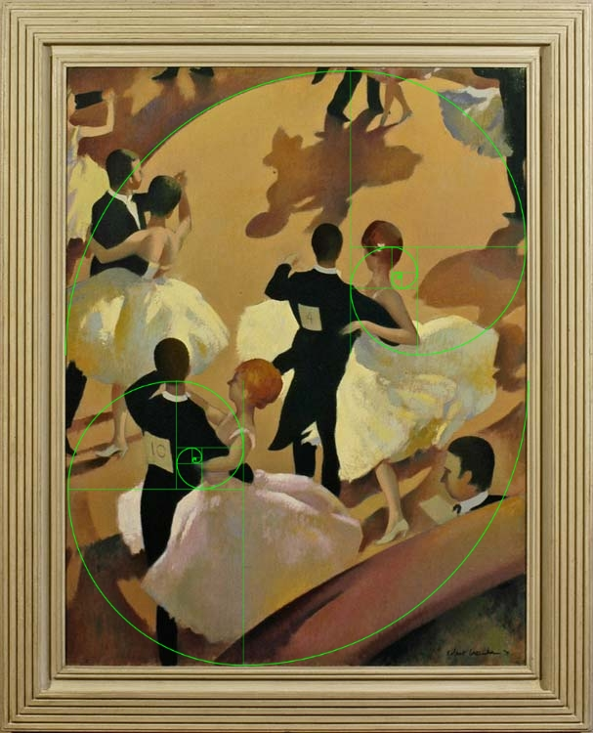
.
As you can see in the image above, the entire composition is perfectly outlined by two Fibonacci spirals, which trace the line of the spotlit dance floor, the skirts and arms of the dancers, and even the curve of the central lady’s neck, and place the focus perfectly on the two foremost couples. This complex, abstract composition makes it very easy to see the Fibonacci sequence at play, following the bold lines as it does, however it can also be found in other, more naturalistic compositions.

Slide 3
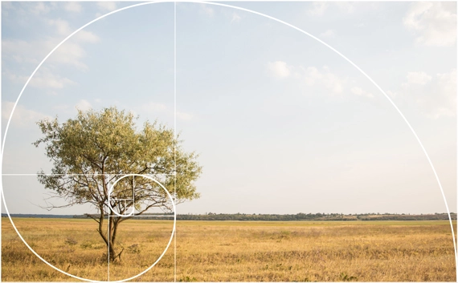
Why do photographers use golden ratio?
In photography, you can use the golden ratio as a helpful tool to create harmonious and pleasing compositions. Since the center of an image is often perceived as static or uninteresting, this division of space is often used in visual composition.

Slide 4
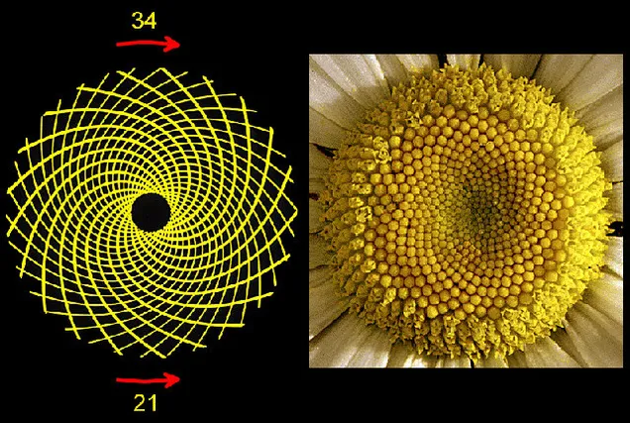
We can also use Fibonacci numbers in nature. The head of a flower is also subject to Fibonaccian processes. Typically, seeds are produced at the center, and then migrate towards the outside to fill all the space. Sunflowers provide a great example of these spiraling patterns.

Slide 5
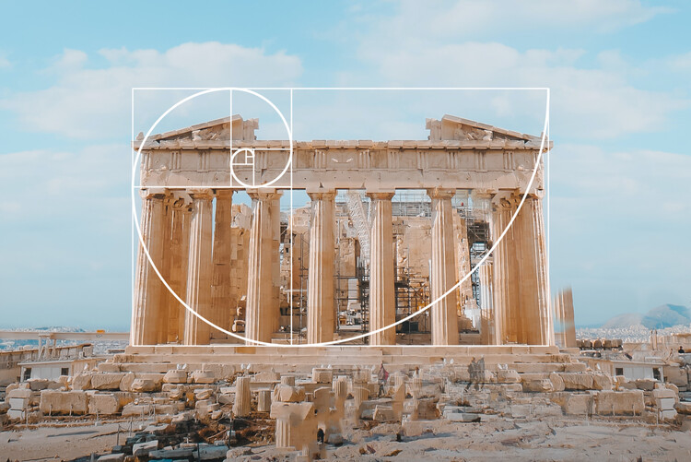
The Golden Ratio is a design concept based on using the Fibonacci sequence to create visually appealing proportions in art, architecture, and graphic design.

Slide 6
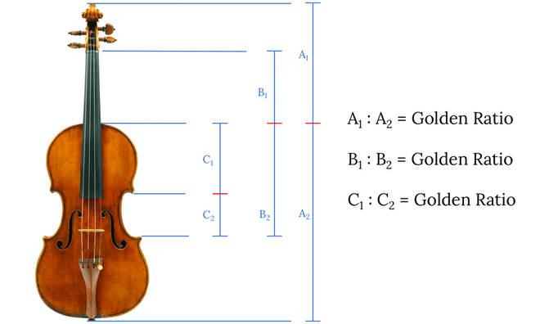
Notes in the scale of western music are based on natural harmonics that are created by ratios of frequencies. Ratios found in the first seven numbers of the Fibonacci series ( 0, 1, 1, 2, 3, 5, 8 ) are related to key frequencies of musical notes.

