Slide 1
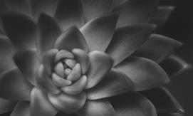
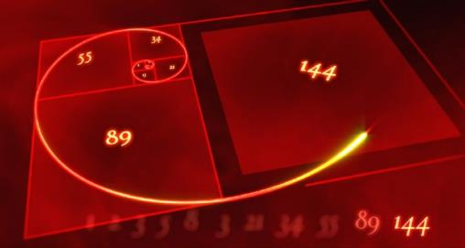
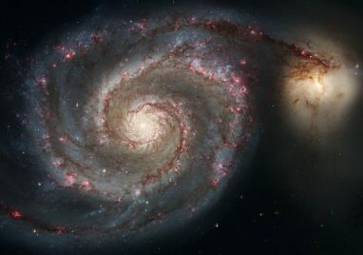
The Fibonacci Art (golden ratio)

Slide 2
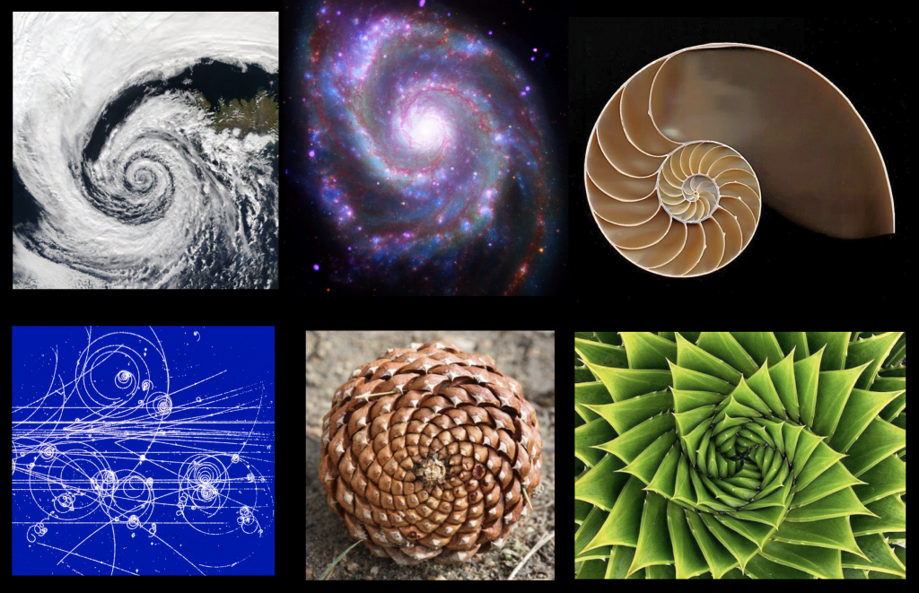
The Fibonacci Art (golden ratio)

Slide 3
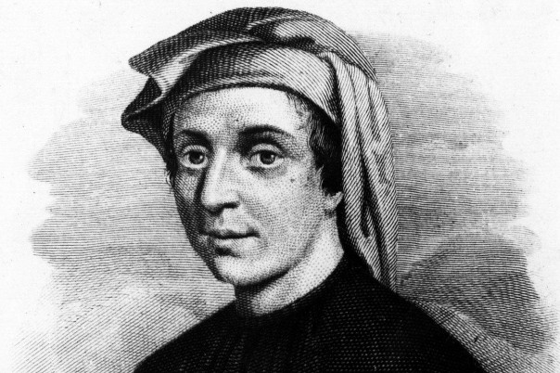
Who is Fibonacci?
The creator of the most famous series of numbers that can be applied in many fields of science and art, he is the most talented mathematician of the Middle Ages, who transmitted almost all the Eastern knowledge of algebra and arithmetic known at that time with his books, at a time when Arabic numbers were not even used in Europe.
1, 1, 2, 3, 5, 8, 13, 21, 34, 55, 89, 144, 233, 377...
This number sequence really does form patterns and geometry found everywhere in nature.
Why does the universe like these numbers so much?
Maybe it’s because nature is always changing and growing and this is the geometry of growth and form.
But first, let’s do the numbers.
Leonardo of Pisa, called Fibonacci - medieval mathematician
(1170 – c. 1240)

Slide 4
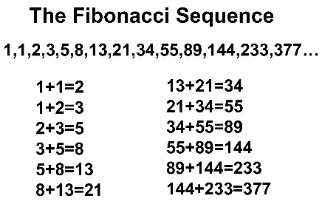
What is the Fibonacci sequence and the Golden ratio?
Fibonacci’s famous number sequence was simple: to get the next number in the sequence, add the previous two numbers.
The Fibonacci Sequence is the series of numbers:
0, 1, 1, 2, 3, 5, 8, 13, 21, 34, ...
The next number is found by adding up the two numbers before it:
the 2 is found by adding the two numbers before it (1+1),
the 3 is found by adding the two numbers before it (1+2),
the 5 is (2+3)…………………………………………………and so on!!!
Example: the next number in the sequence above is 21+34 = 55
It is that simple!
Here is a longer list:
0, 1, 1, 2, 3, 5, 8, 13, 21, 34, 55, 89, 144, 233, 377, 610, 987, 1597, 2584, 4181, 6765, 10946, 17711, 28657, 46368, 75025, 121393, 196418, 317811, ...
Can you figure out the next few numbers?

Slide 5
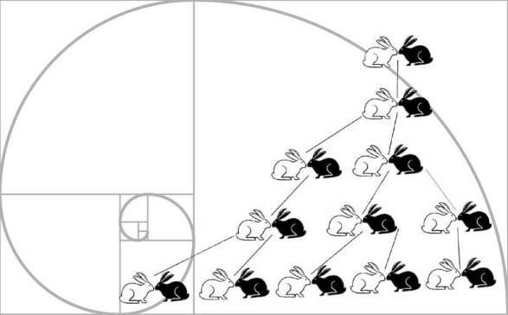
Fibonacci came to the discovery of the sequence in a special way, researching the laws of reproduction of animals, especially rabbits.
It was his answer to a popular number riddle:
“Suppose a pair of rabbits, male and female, are able to mate and every month their offspring produce a pair of male and female rabbits. How many rabbits will there be in one year? ”
The answer is 144, a Fibonacci number. As we’ll see, this sequence and the geometry it forms can be found throughout the natural world.

Slide 6
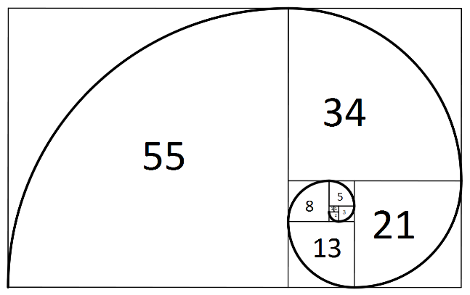
Fibonacci spiral and “golden ratio”
Beyond the significance of the number series itself, graphically it is represented as a series of geometric shapes which when added on to each other create a series of "golden rectangles"- meaning, aesthetically a rectangle of optimal proportions. Taking it one step further and introducing a quarter circle into each of the shapes, a spiral is formed. While not a perfect spiral, it is a shape that is seen in nature in a number of different ways: the shape of shells of snails and seashells, fiddleheads, waves, cyclones--even the galaxy itself!
Then there is how the ratios of the rectangle equal the number φ=1.61803....(ad infinitum), or the "golden ratio"

Slide 7
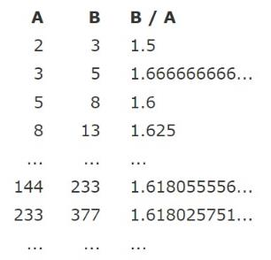
How to reach the golden ratio with Fibonacci numbers?
Here’s where it gets weird.
What mathematicians discovered about the Fibonacci sequence is that the ratios of the successive numbers in the Fibonacci sequence – that is, dividing one number in the sequence by the previous one – the result will be closer and closer to 1.618. The higher the numbers chosen, the closer the result is to the golden ratio.
8/5= 1.6
377/233= 1.61802575…
…
2584 /1597 = 1,16179325…
1.618… is called Phi for short. I put ellipsis after it because the decimals go on to infinity). Because Phi is an irrational number, it goes to infinity, never repeating, getting ever closer to Phi, but never reaching a precise, definable quantity.
Once they discovered it in nature, artists, philosophers, mathematicians, and architects used this ratio in their work. They passed this secret formula down through the centuries to create what is considered the most harmonious relationship between visual elements. There’s just something about it. It’s a dynamic form–the brain tries, but just can’t quite map out this rectangle using simple numbers. That’s because it’s based on an irrational number.

Slide 8
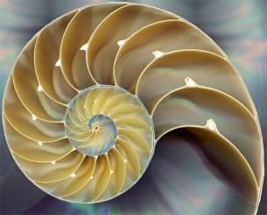
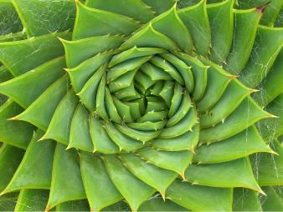
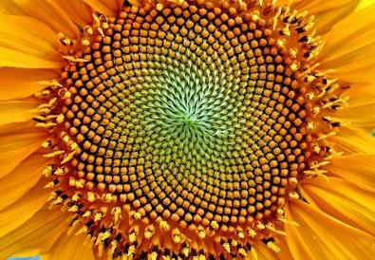
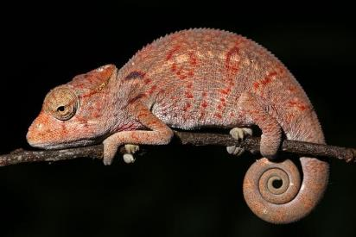
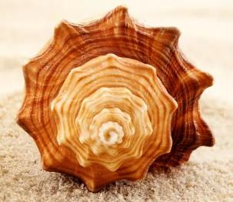
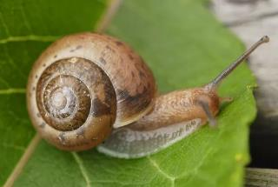
Fibonacci sequence in nature
Today, it is known that these numbers play a big role in many natural processes, such as the arrangement of leaves around a plant's stem, the creation of natural spirals that we encounter all around us, from the curvature of waves, or a snail's house, all the way to the Milky Way itself.

Slide 9
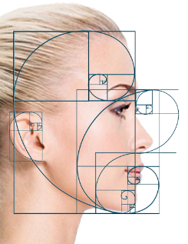
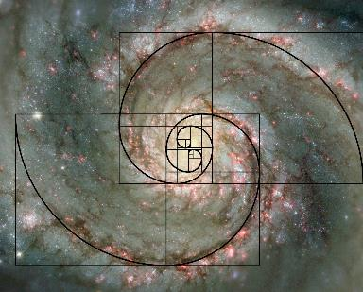
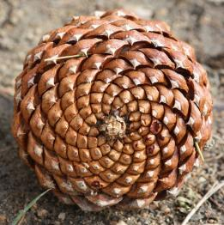
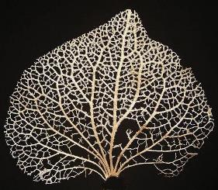
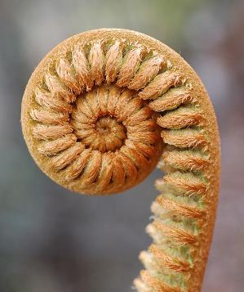
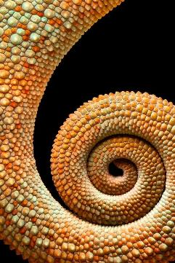
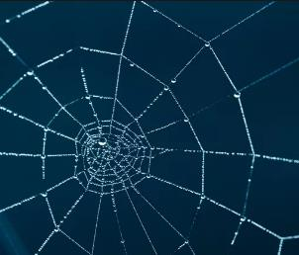
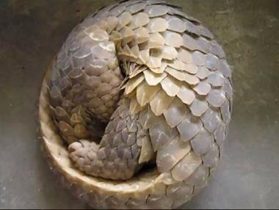
Fibonacci sequence in nature

Slide 10
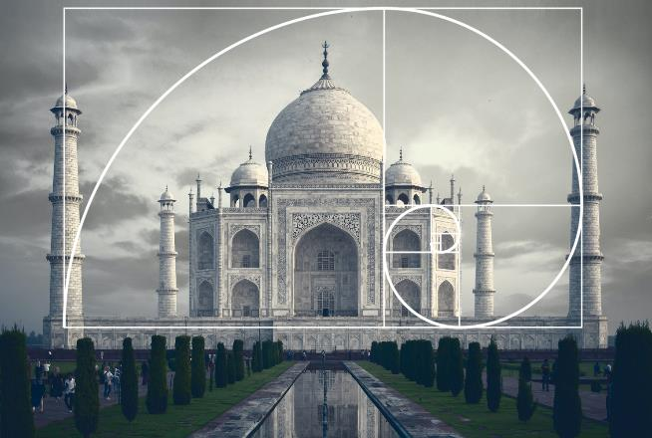
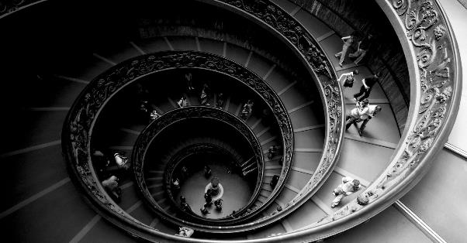
Fibonacci sequence in architecture
Antiquity already studied this proportion given by the Golden ratio and applied it in their constructions and artistic works, as it was said that it has the characteristic of being naturally pleasing to the human eye.

Slide 11
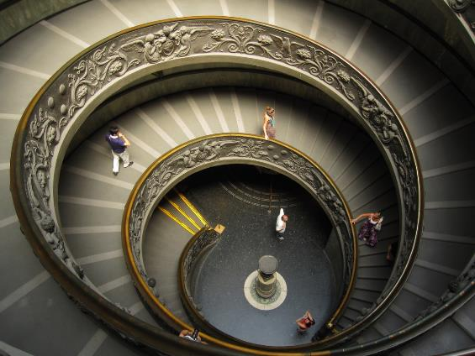
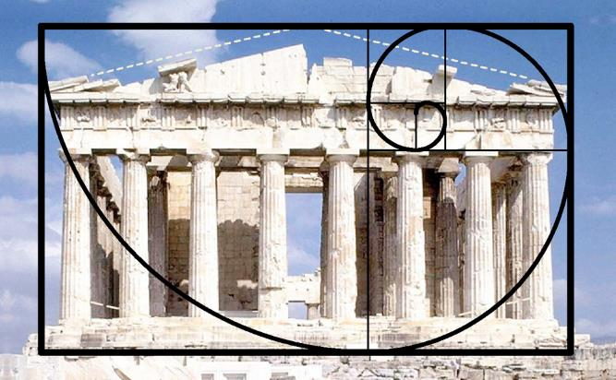
Fibonacci sequence in architecture
Therefore, it can be verified in several architectural works such as the Parthenon, in which the width and height of the facade follow the golden proportion; in the Egyptian Pyramids, in which each block is 1.618 times larger than the block on the level immediately above, and in some of them the inner chambers are 1,618 times as long as they are wide; and even at the Taj Mahal, which some theorists link its design to the proportion of Golden ratio.

Slide 12
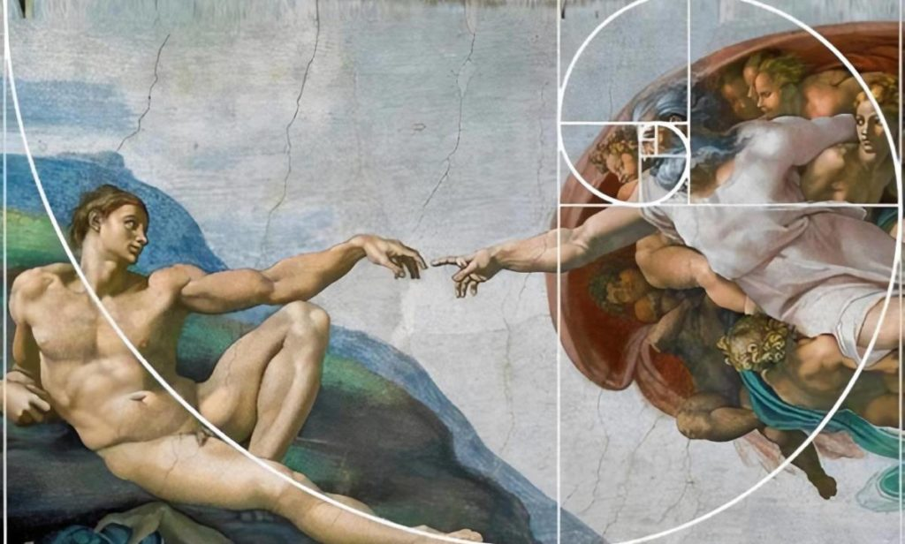
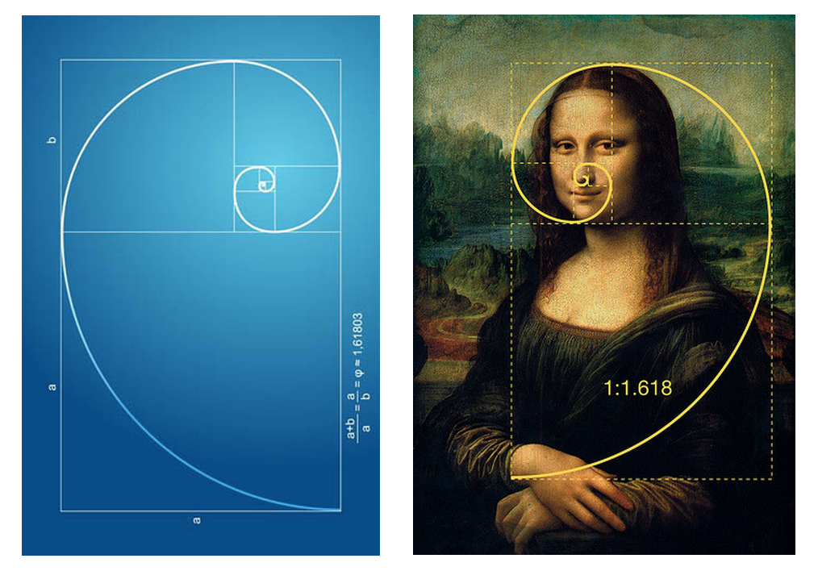
What kinds of artworks can we design using Fibonacci numbers?
The golden section and the Fibonacci numbers have impressed great minds and gave us some of the most beautiful artworks we can enjoy today. It doesn’t matter if mostly we have approximations or adaptations of this mathematical properties, but since even nature prefers imperfection to solve his problems, the results of these researches are often astonishing.
From Piet Mondrian to Jacques Villon, from le Corbusier to Mario Botta; countless artists have used the Fibonacci sequence in their art. These artworks provoked a growing interest for mathematical principles. The importance of math in art increased, becoming a must for some artists such as Mario Merz, whose works are mostly related to the Fibonacci numbers.
Fibonacci believed that calculation was an art form; to him, it was a “marvelous” thing of beauty. He considered the art of calculation with Hindu-Arabic numerals to be appealing because their use facilitates the creation of harmonious, orderly, proportionate dimensions.

Slide 13
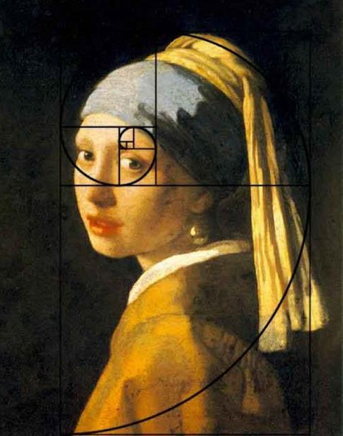
Fibonacci in art
How is Fibonacci numbers used in art?
Artists recognized that the Fibonacci Spiral is an expression of an aesthetically pleasing principle – the Rule of Thirds. This is used in the composition of a picture; by balancing the features of the image by thirds, rather than strictly centring them, a more pleasing flow to the picture is achieved.

Slide 14
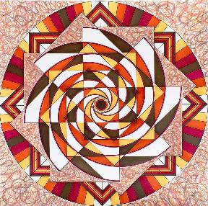
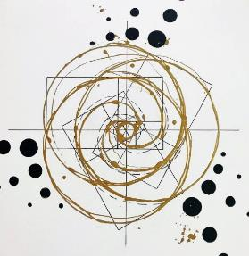
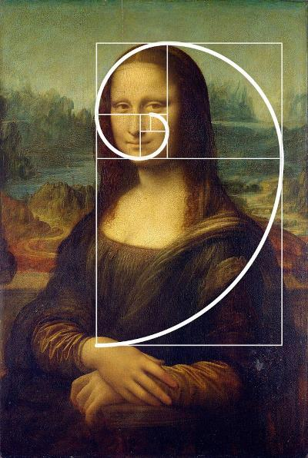
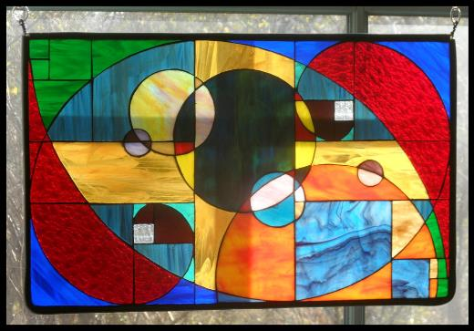
Fibonacci in art

Slide 15
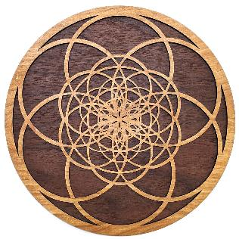
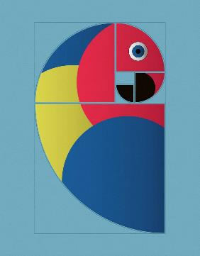
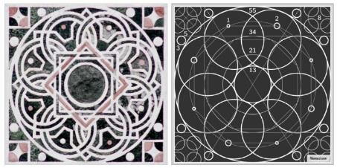
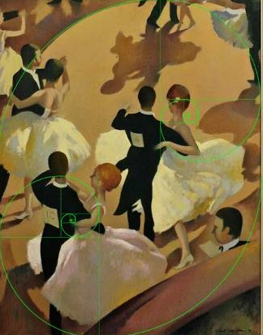
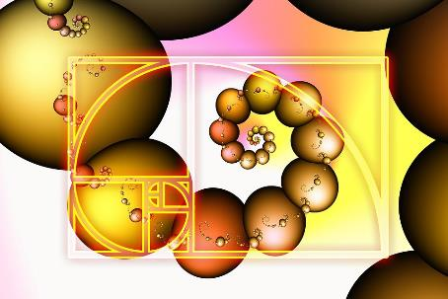
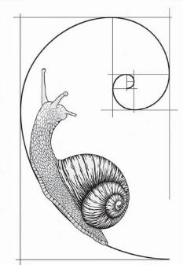
Fibonacci in art

Slide 16
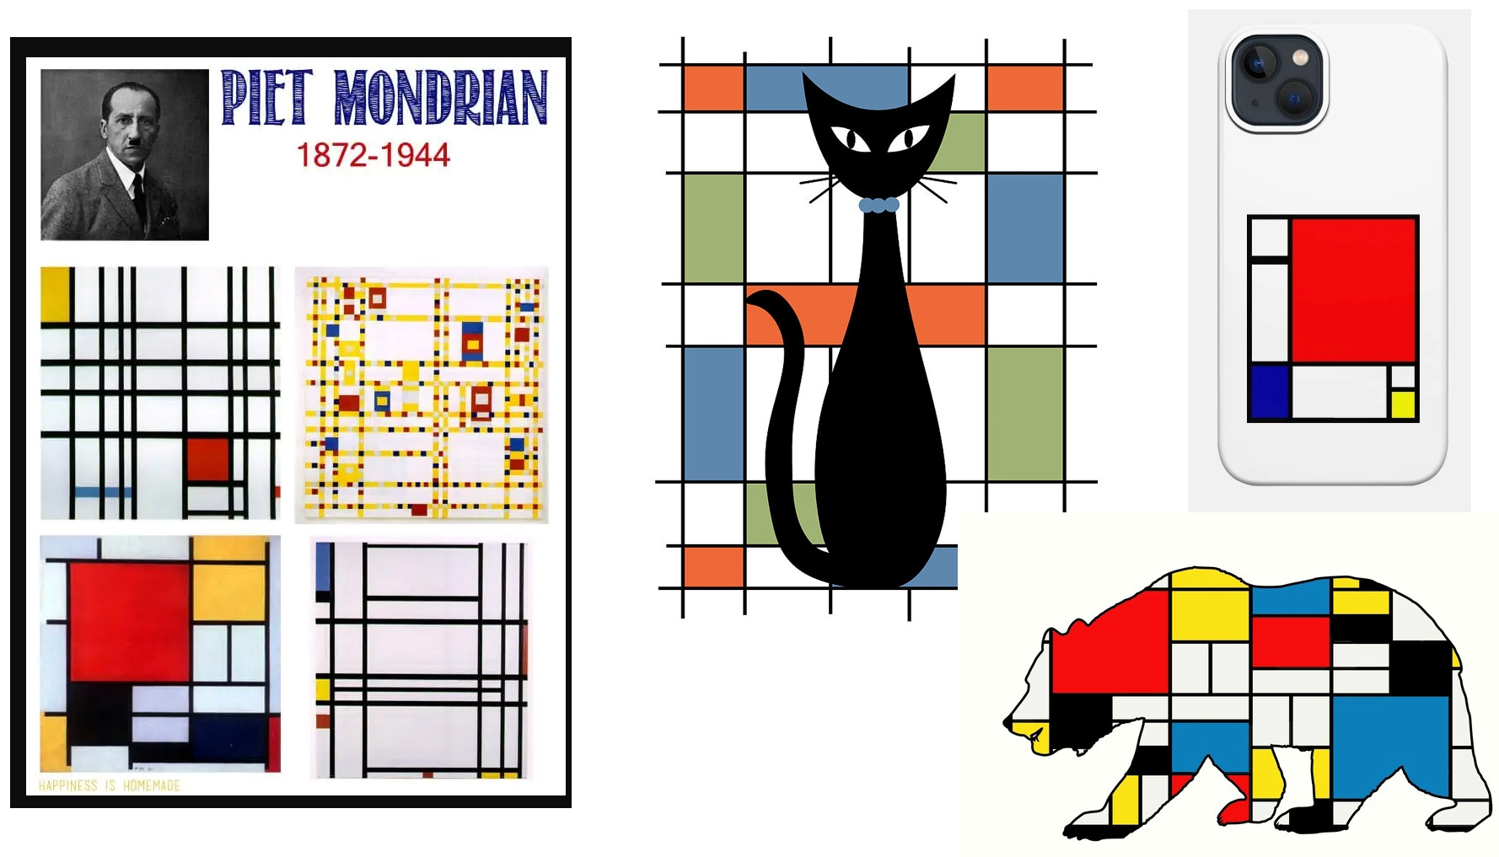
Fibonacci in art
Pet Mondarian often used the golden ratio to compose his paintings.
There are a lot of designs inspired by Mondarian paintings

Slide 17
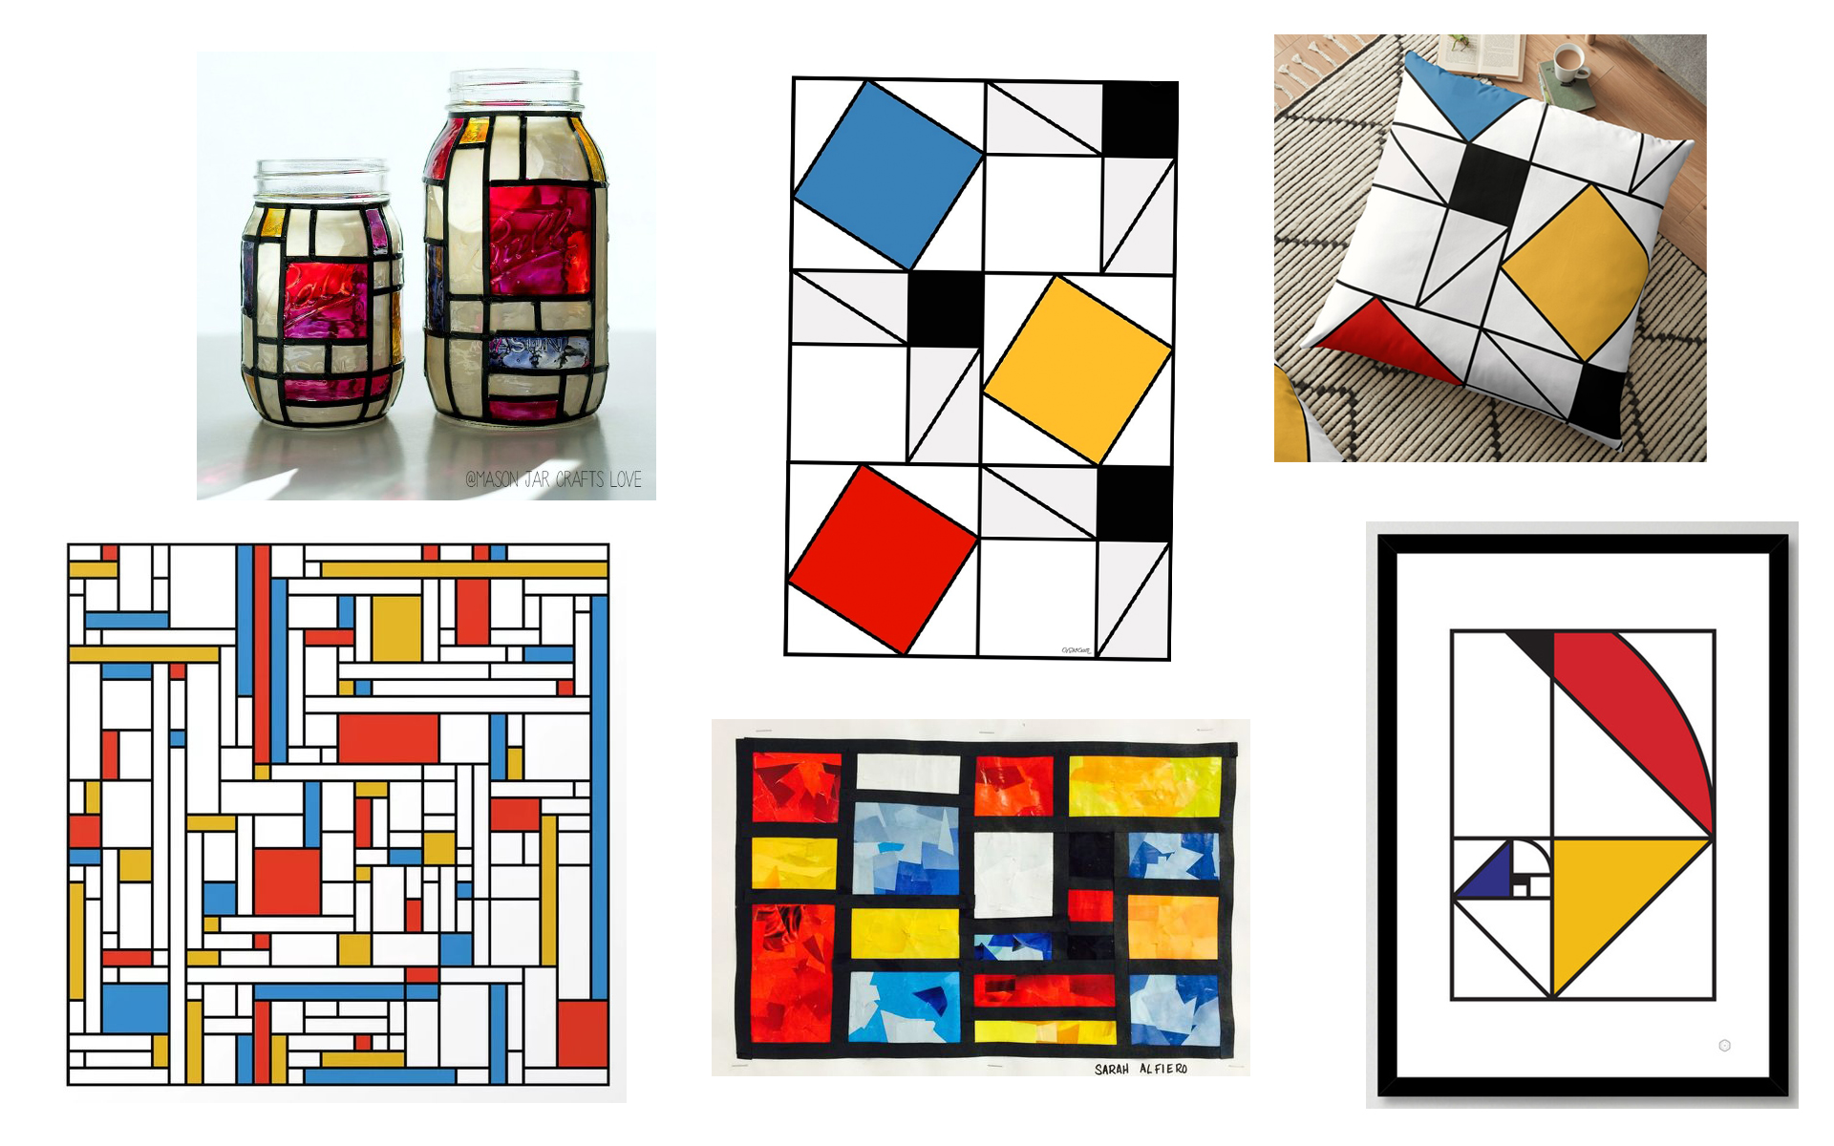
Fibonacci in art

Slide 18
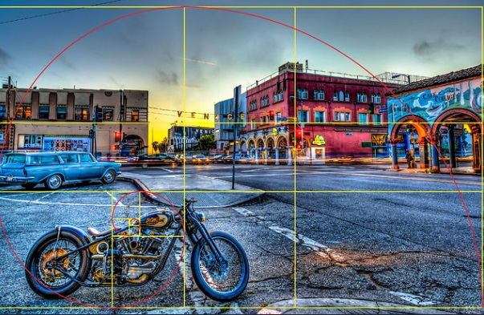
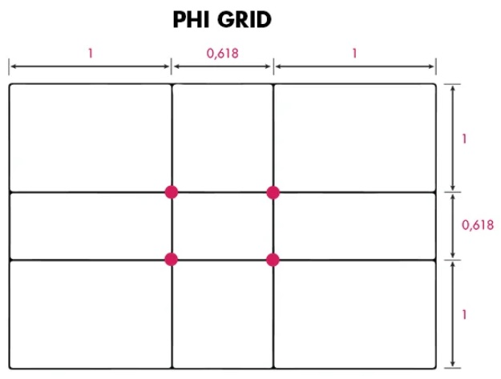
How to Use the Golden Ratio in Photography Composition?
By using the golden ratio, you can create a photo that is more pleasing to the eye in a natural way.
It helps to lead the viewer through the entire photo. The composition will be more pleasing and balanced.
Following the sequence of Fibonacci numbers can create an aesthetically pleasing art composition.
Even if you dislike maths, this concept can change your composition from good to excellent.
There are several ways to use the golden ratio. The Phi Grid and the Fibonacci Spiral are the most common ones applied in photography.
The Phi Grid is another way of considering proportion in photography. It looks like the Rule of Thirds, but you are not dividing the frame into equal thirds. The grid consists of a 1:0.618:1 ratio instead of the usual 1:1:1. The centre lines are closer to each other.
Using this method means that your subject is located a bit more central.
This way, your composition will be more unique and draw the viewer’s attention quickly to your subject.

Slide 19
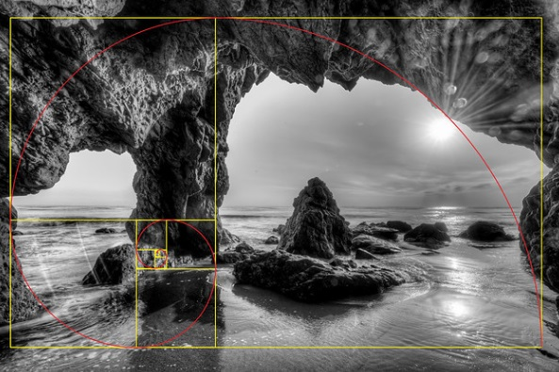
How to Use the Golden Ratio in Photography Composition?
How do you use the Golden Ratio in photography?
You should place the area with the most details in the smallest box of the coil. This does not have to be in one of the corners. It can be anywhere in the frame.
Try to position the rest of the subject within the curve too.
This will lead the eye of the viewer through the image in a natural way.

Slide 20
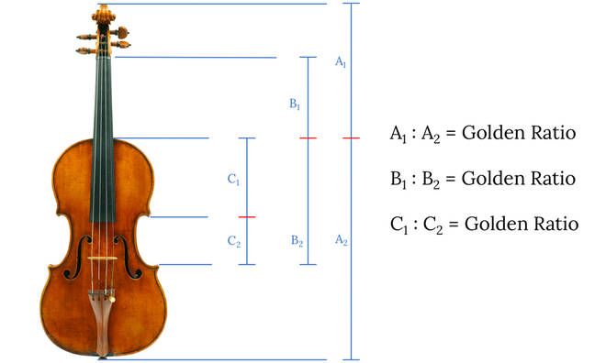
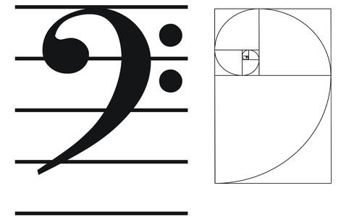
Fibonacci in music
In music, we can also find some other examples of using the golden ratio or the Fibonacci numbers. Béla Bartók probably used the sequence in his Music for Strings, Percussion and Celesta and other compositions, just as Erik Satie for his Trois sonneries de la Rose+Croix. Even Claude Debussy, the composer of Images and the famous Clair de Lune had divided the sections of his Nocturne n°1, also called “Nuages” by the Fibonacci Numbers.
Erik Satie - Sonneries de la Rose+Croix - 3. Air du Grand Prieur

Slide 21
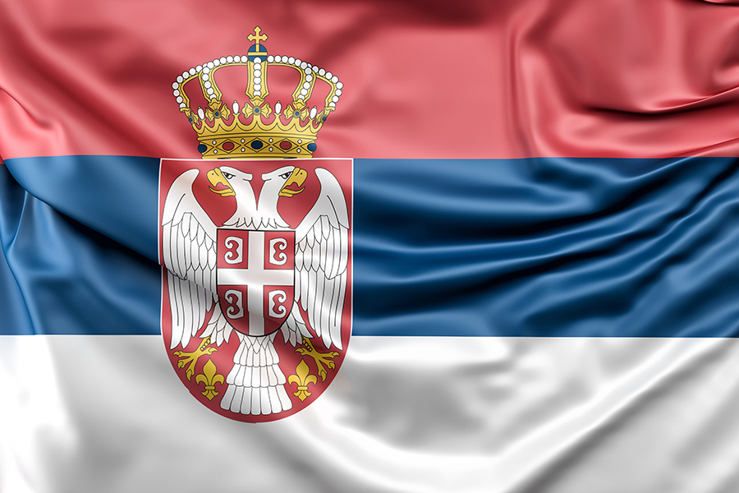
Thank you for your attention!
BYE!!!

