Slide 1
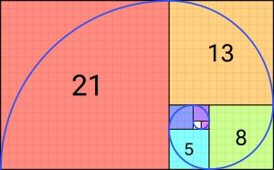
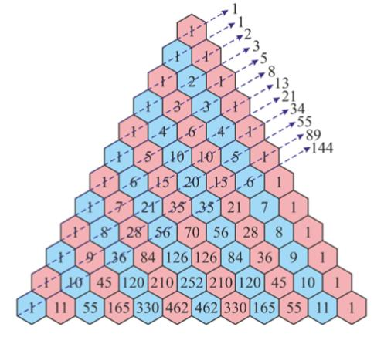
How to reach the golden ratio using fibonacci numbers?
.

Slide 2
What is Fibonacci sequence?
The Fibonacci sequence begins with the following 14 integers: 0, 1, 1, 2, 3, 5, 8, 13, 21, 34, 55, 89, 144, 233 ...
Each number, starting with the third, adheres to the prescribed formula. For example, the seventh number, 8, is preceded by 3 and 5, which add up to 8.

Slide 3
Answer is:
You can reach golden ratio when you devide bigger number with smaller number from the sequence. For example: 89 devided by 55 is 1.6
You can also reach the Golden Ratio when you divide a line into two parts and the longer part (a) divided by the smaller part (b) is equal to the sum of (a) + (b) divided by (a), which both equal 1.618. That is how we reach golden ratio.

Slide 4
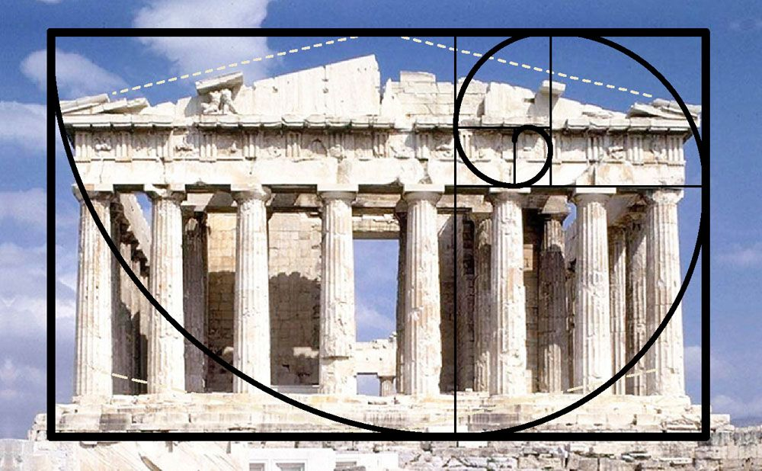
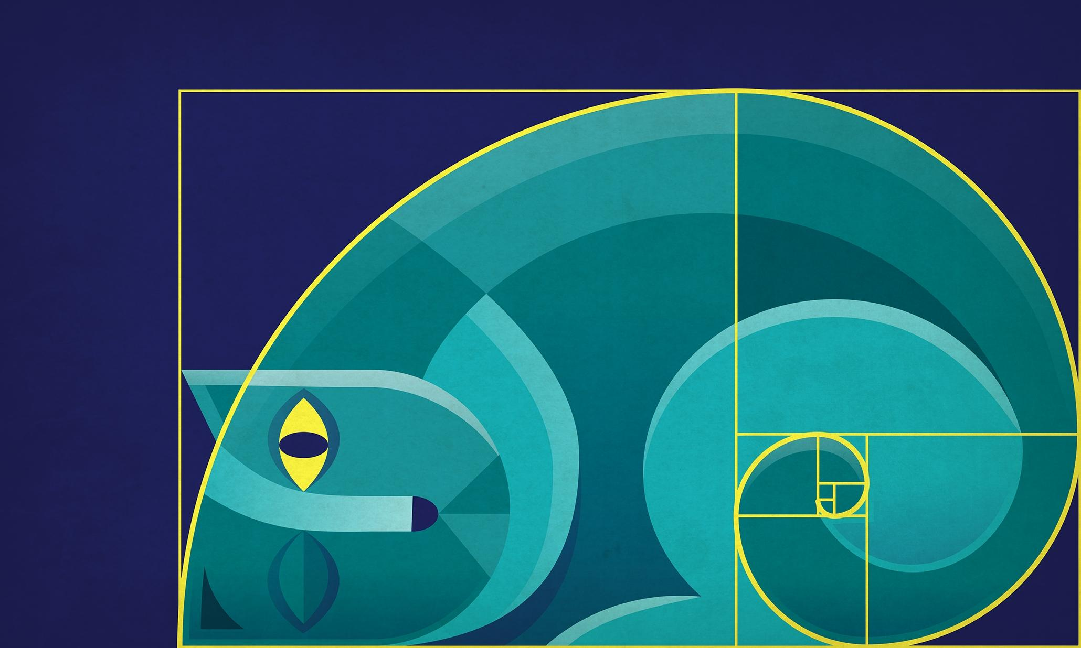
Why is golden ratio more pleasing to the eye?

Slide 5
Answer is:
Scientists believe this proportion is the easiest for the eye to scan for, and process, important details, especially when the longer side is horizontal.
. Shapes that resemble the golden ratio facilitate the scanning of images and their transmission through vision organs to the brain.

Slide 6
Is there a connection of Fibonacci sequence and music?
Musical frequencies are based on Fibonacci ratios
Notes in the scale of western music are based on natural harmonics that are created by ratios of frequencies. Ratios found in the first seven numbers of the Fibonacci series ( 0, 1, 1, 2, 3, 5, 8 ) are related to key frequencies of musical notes.
Numbers in the Fibonacci sequence can be seen on a piano keyboard and in the musical scales. For example, scales along a piano keyboard are composed of thirteen keys in the span of a full octave which consists of eight white keys and five black keys that are arranged in groups of two and three along the keyboard.

Slide 7
fun fact!
Many people believe that the golden ratio (1.6 ) is the connection between religion and science. Because of the fact that golden ratio is displayed so much in everyday life. Simple observation confirms that Fibonacci numbers are represented by many human parts: one trunk, one head, one heart, etc. Then there are pairs: arms, legs, eyes, ears. Its not only in our bodies, but everywhere in nature. That proofs the point. Some people say that nothing is a coincidence!

Slide 8
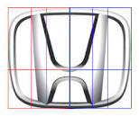
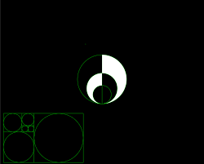
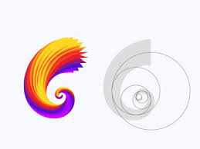
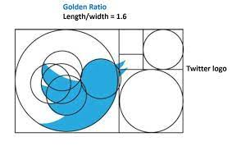
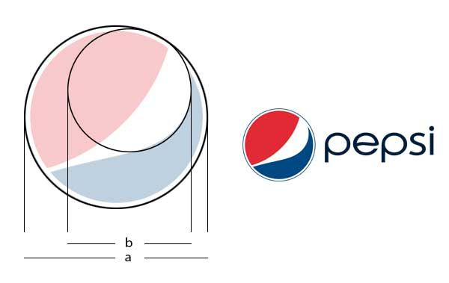
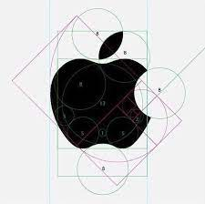
We can also see Fibonacci sequence on many brand logos
.

Slide 9
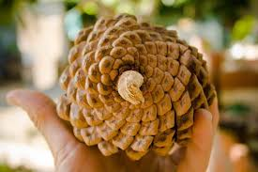
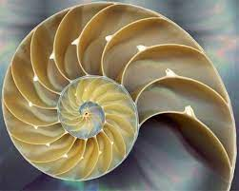
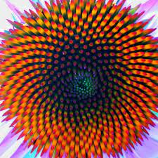
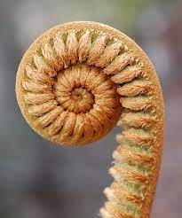
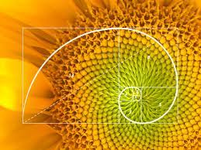
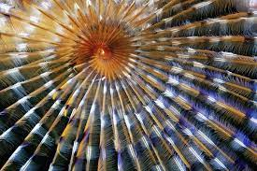
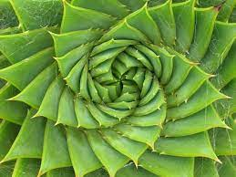
examples of golden ratio in nature:
.

Slide 10
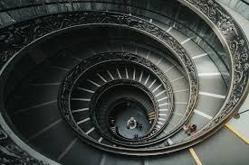
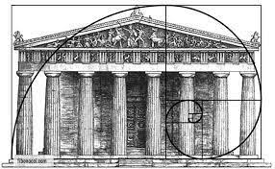
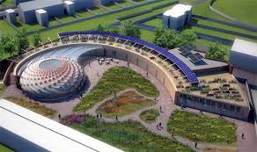
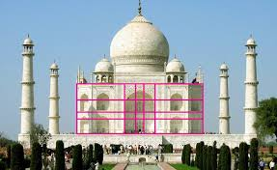
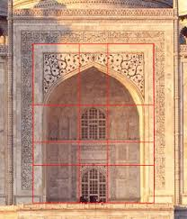
examples of golden ratio in architecture:

