Slide 1
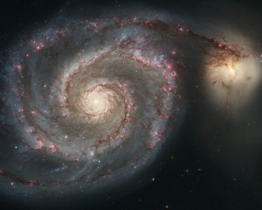
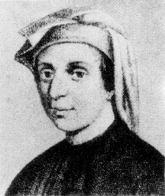
WHO IS FIBONNACI? WHAT IS FIBONNACI SEQUENCE AND THE GOLDEN RATIO?
By:Šejla Demiri and Nađa Stanković

Slide 2
Who was Fibonacci?
Fibonacci named Leonardo Bonacci, famous like Leonardo of Pisa. He was Italian mathematician from the Republic of Pisa. He was also famous "The most talented Wester mathematician of the middle ages". He was born around 1170. Fibonacci traveled with his father Guglielmo Bonacci in Bugia (Algeria) where he was educated and he learned about the Hindu-Arabic numeral system. His mother was Alessandra Bonacci,he also had a brother Bonaccinghus Bonacci.He died at 1250,and he lived around 80 ages.

Slide 3
What is fibonacci sequence?
Fibbonacci sequence is sequence of numbers which the first two numbers are 0 and 1,and each subsequent number is the sum of the previous two numbers.Fibonacci sequence helped with the growth of the rabbits population.

Slide 4
WHAT IS GOLDEN RATIO?
The Golden Ratio,also known as golden number,golden proportion or divine proportion,is a ration between two numbers that is close to 1.618.Commonly written as the Greek letter 𝛑,it is closely related to the Fibonacci sequence.The golden ratio can be found in the buildings,the anatomz of human body,art and many other things.

Slide 5
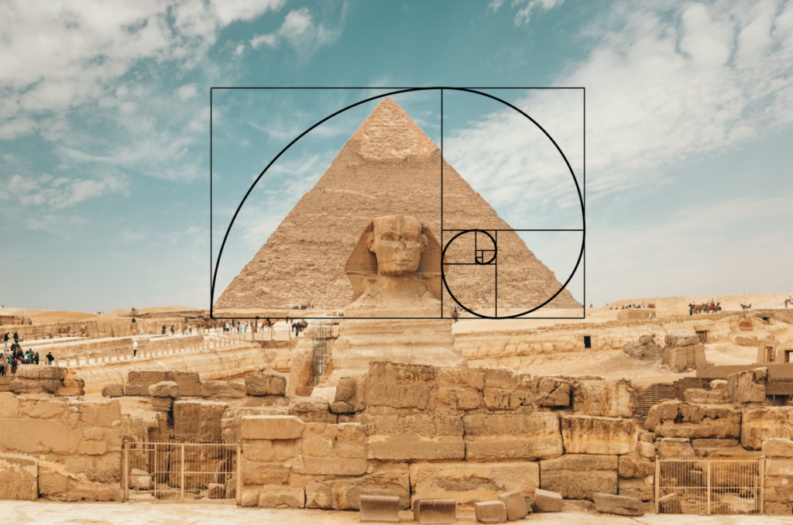
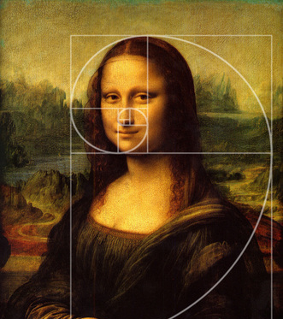
. THE Golden Ratio the golden ratio is very important for our history bescause important works were made with the help of the golden ratio

