Slide 1
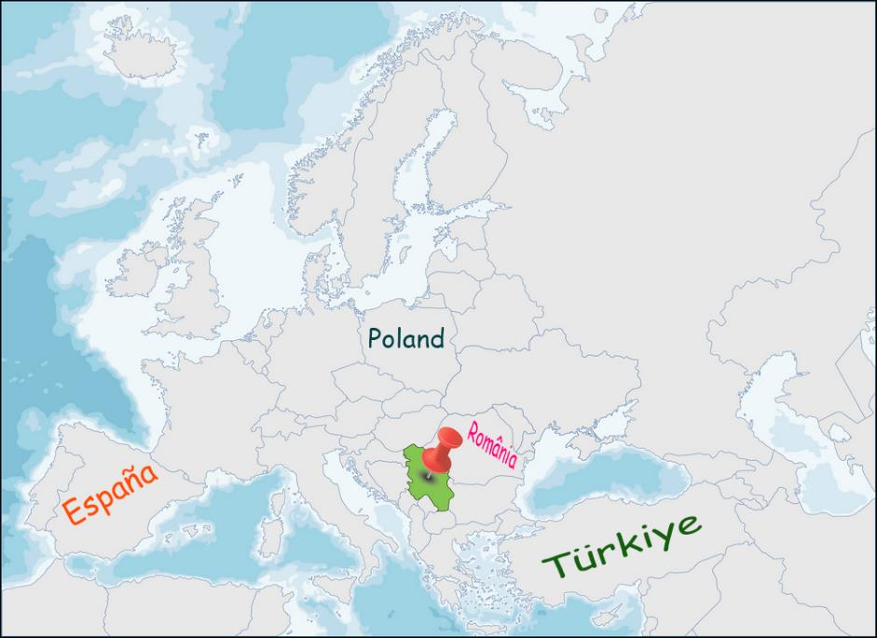
Republika Srbija
Population: 7,500,000
Cities: Belgrade (capital), Novi Sad, Nis, Subotica, Kragujevac
Official Language: Serbian
Religion:Orthodox

Slide 2
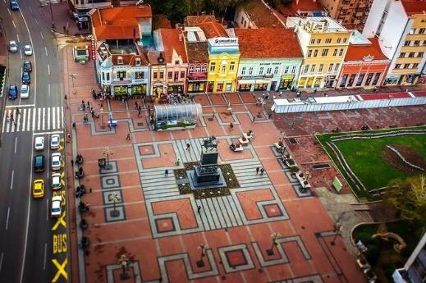
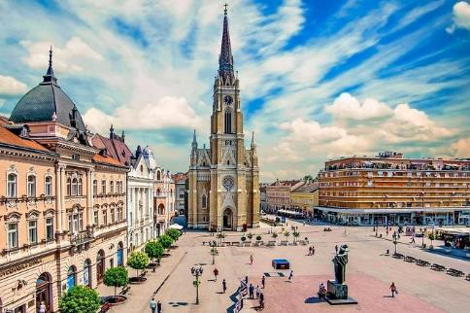
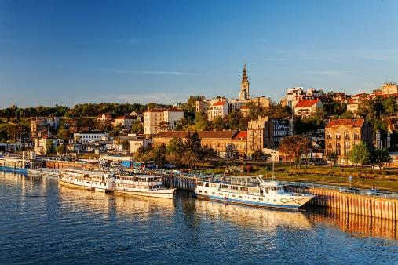
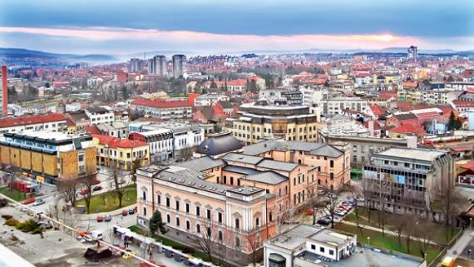

Slide 3
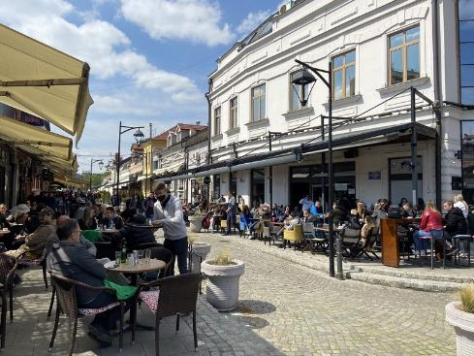
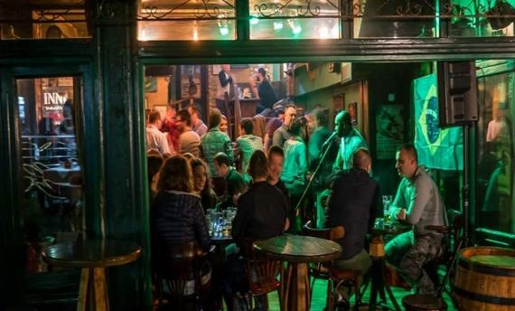
In Serbia, all coffee shops, pubs and restaurants are always full. The first comment from visitors is almost always:
Do these people ever work?

Slide 4
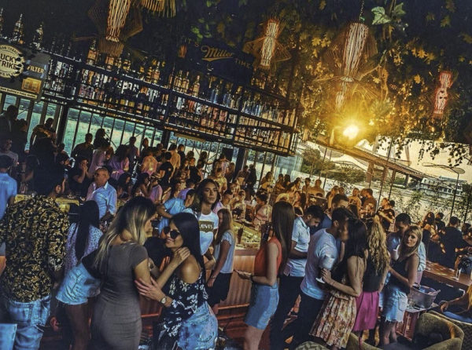
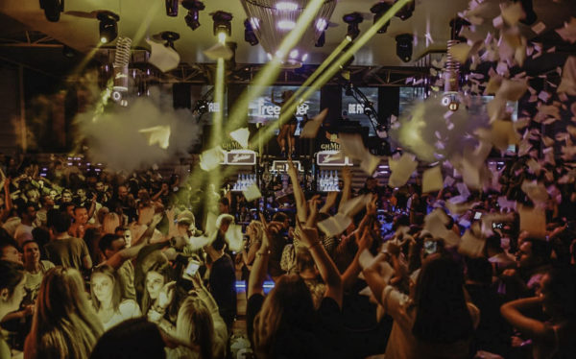
Belgrade, the capital city
Fancy some nightlife? Head to Belgrade; Lonely Planet has voted as the city with the best nightlife on the planet!

Slide 5
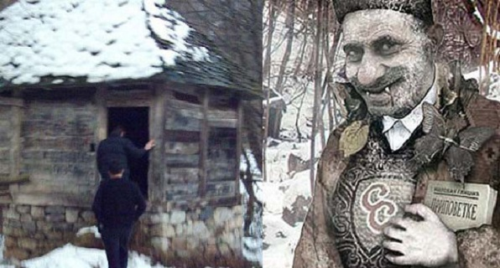
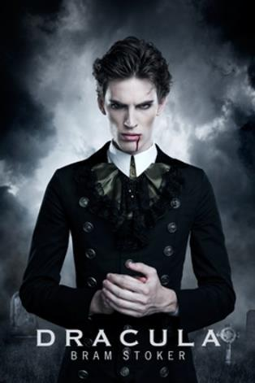
The world’s first vampire?
Do you think it’s Dracula?
Wrong! The first vampire was Petar Blagojevic, from Serbia

Slide 6
Most last names in Serbia end in ‘ić.’
Jovanović
Popović
Trajković
Andrić
Antić
Pametnjaković
Kitanović
Đoković
Stojanović

Slide 7
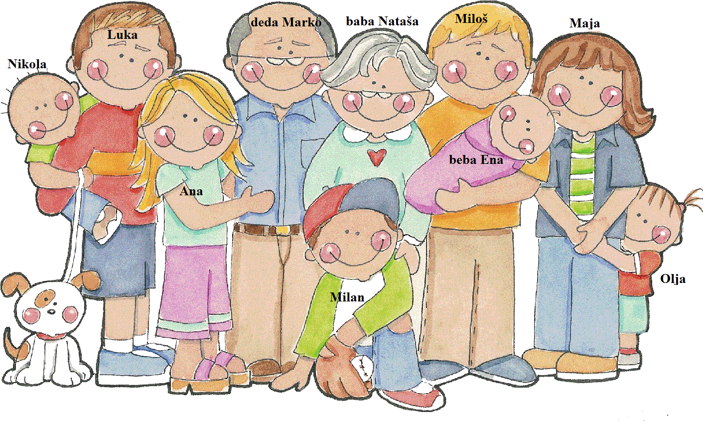
In Serbia, the family and mutual support among members are highly valued. It is common for multiple generations to live under the same roof. Grandparents often help to look after grandchildren while the parents are at work. It is also commonplace for children to take care of their parents as they age.

Slide 8
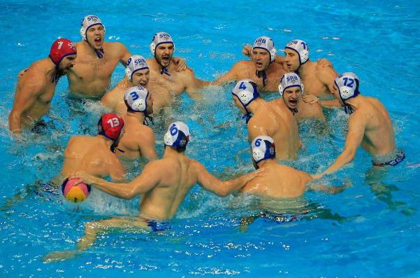
Serbia doesn’t have sea and yet has the best water polo team in the world - The Dolphins

Slide 9
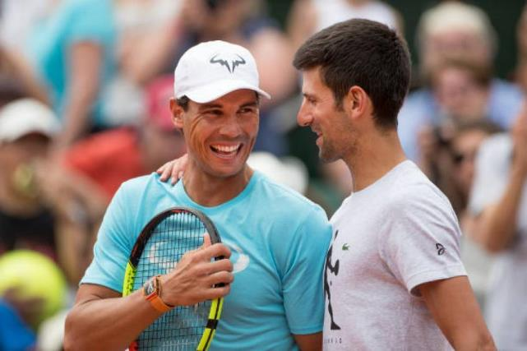
Best tennis player in the world?

Slide 10
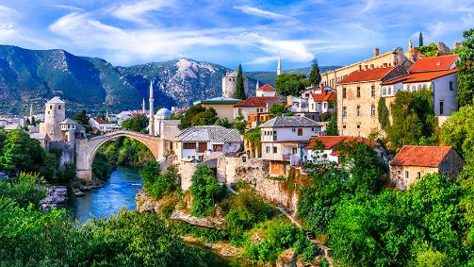
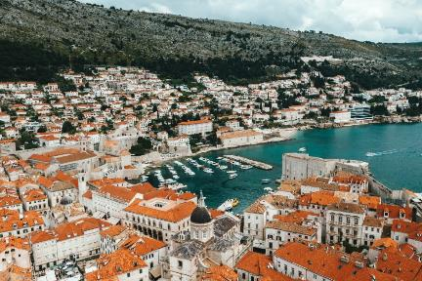
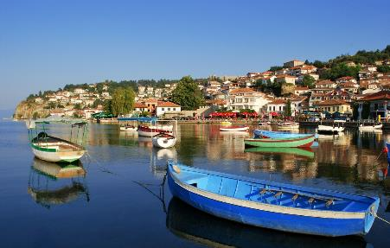
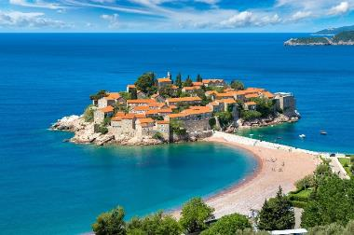
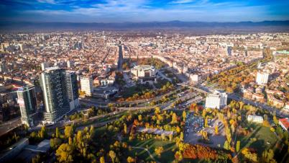
There's a saying in Serbia: "Speak Serbian so the whole world understands you."
If you speak Serbian, you can visit Bosnia, Croatia, Montenegro, Macedonia and even Bulgaria – countries that surround Serbia, and they will all understand you.

Slide 11
And Chicago, too ;)

Slide 12
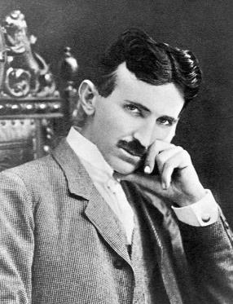
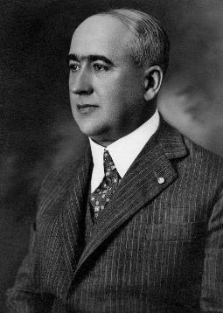
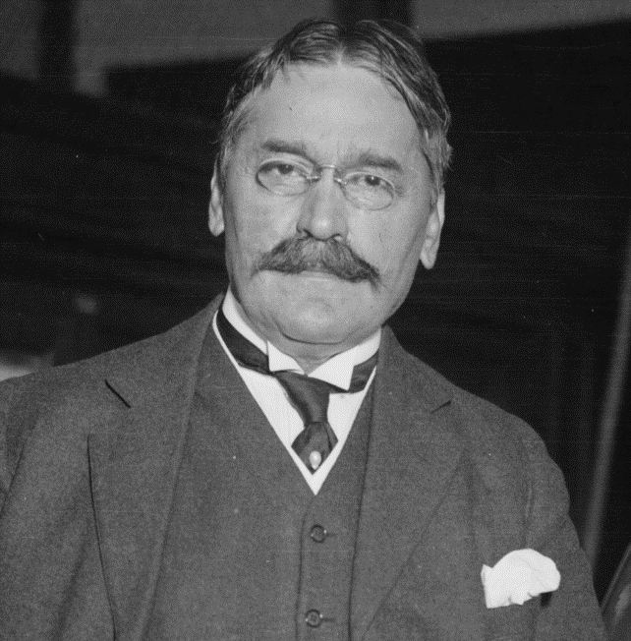
Some of the most famous scientists in the world are from Serbia – Nikola Tesla, Mihajlo Pupin, Milutin Milankovic
Mihajlo Pupin
Nikola Tesla
Milutin Milankovic

Slide 13
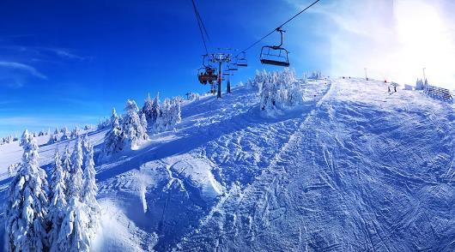
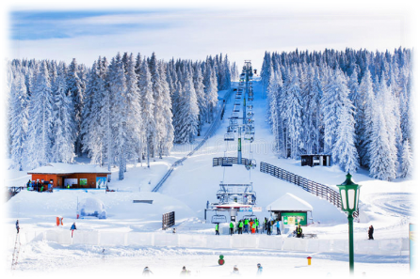
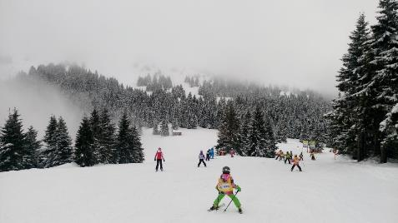
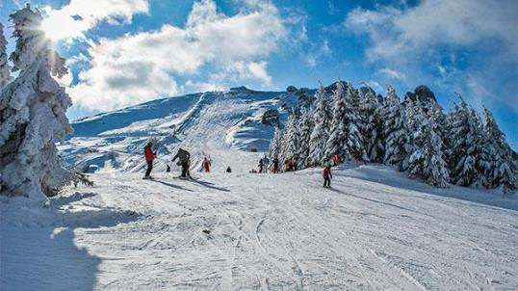
There are many beautiful mountains

Slide 14
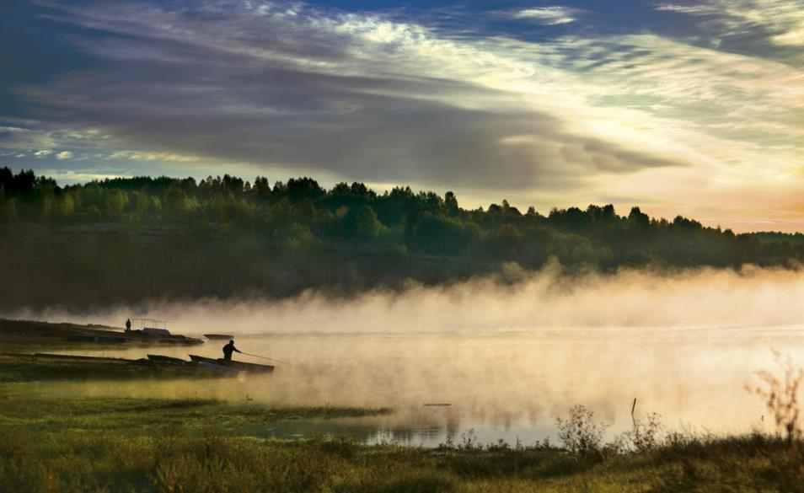
And lakes, too

Slide 15
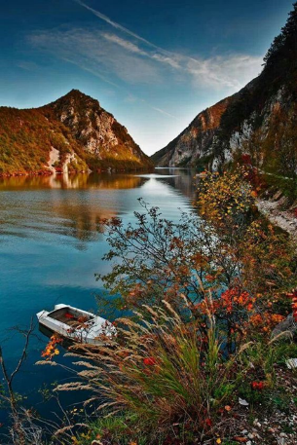
Perucac

Slide 16
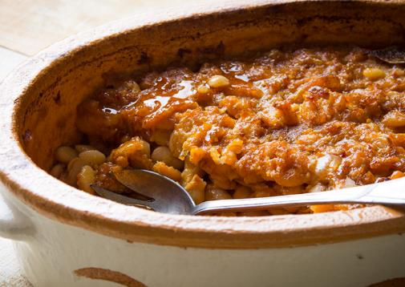
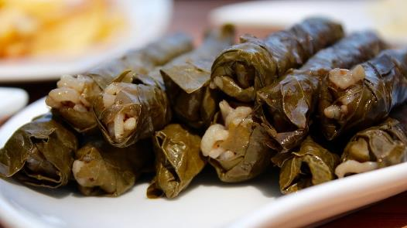
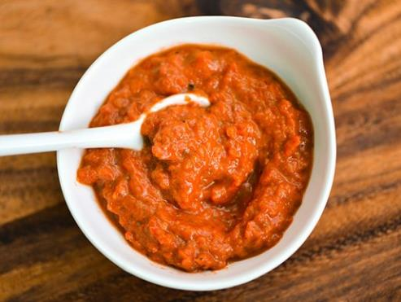
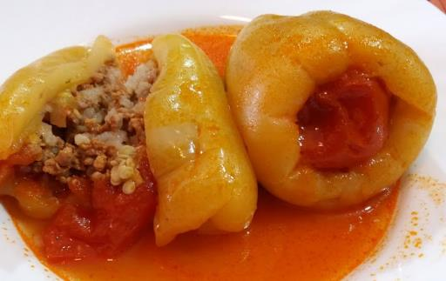
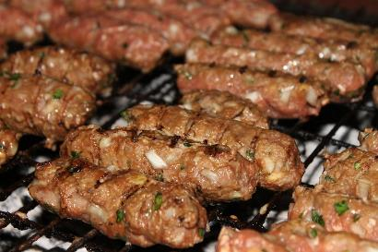
Serbian food is various and very delicious

Slide 17
Serbs have an awesome traditional cuisine and really like to eat!

Slide 18
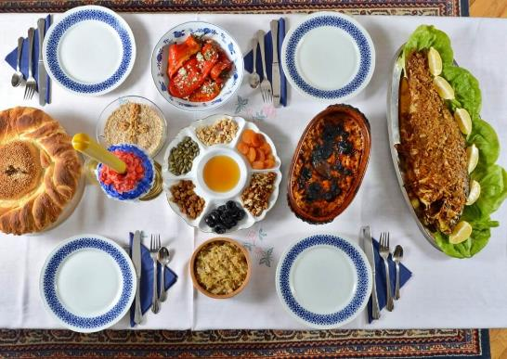
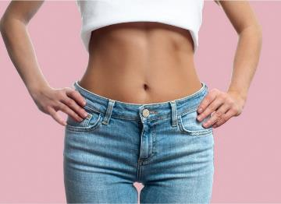
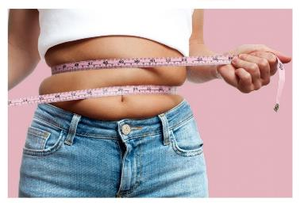
SLAVA – what makes Serbs different from other Orthodox
This traditional and church custom is the second largest (after Christmas) family holiday and the characteristic of spiritual and family life in Serbia.
It is the family holiday when with prayer and rituals family remembers their ancestors who celebrated the same saint.
Not everything is about food on “slava”, but, here is what you look before and after it

Slide 19
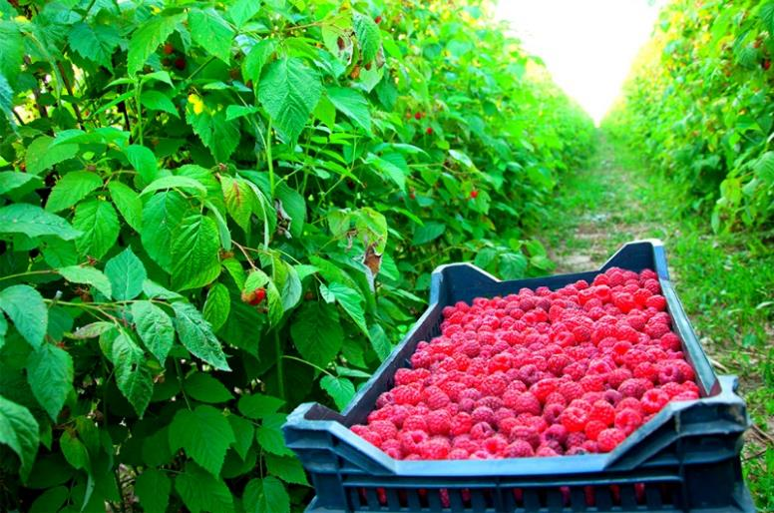
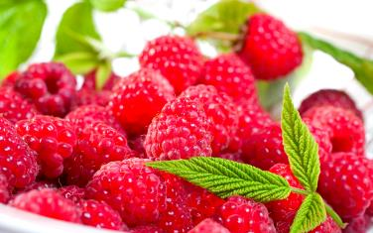
Serbia – sweet raspberry heaven
Raspberries, Serbia’s red gold, are grown in every part of the country

Slide 20
Lifting 3 fingers ( thumb and his neighbors – not some other three fingers ) is a Serbian tradition. So if you want to show locals that you love Serbia, it is a good way to do it. And don`t be surprised when people do that while taking a picture with you, just go with it. It`s our local way of communication and it doesn`t offend anyone.

Slide 21
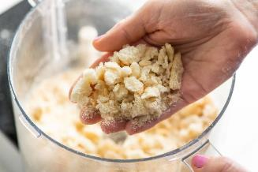
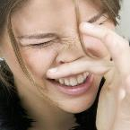
People in Serbia are very superstitious. It’s like a big thing in our culture. For some, this is funny, for some it’s irrelevant, but for some it’s scary. Here are some of them:
If you want to be rich, or at least not be poor, you shouldn’t eat bread crumbs!!!
If you want to have money, don’t ever put your bag on the floor!
- If your left palm itches you, it’s a good sign! It means you’ll receive some money! But, if your right hand itches, that means you’ll have to give some money!
If you’re a woman and you want to get married, DO NOT sit in the corner of the table!!
And, if you want your mother-in-law to love you, eat the end of the bread, so called “rupce”
- You should know this, if your nose itches, it means you’re going to get angry
If you want your baby to grow up tall, make sure that baba pulled up on his ears when he was a baby.
- If you have a hiccup, then someone is thinking about you, or someone is gossiping about you
- If you want to have a beautiful boyfriend or girlfriend, you should eat everything from your plate!

Slide 22
Open door, open window, and between – promaja! something that we know and the whole world has no clue about
Draft- promaja, is our greatest enemy. What else can kill us? Well, cold concrete, going out with wet hair, walking with bare foot…

Slide 23
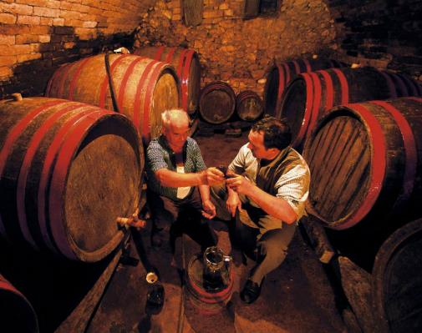
Rakija – not just a national drink, it’s the mother of all cures too!
You skinned your knee
Rakija is not just an alcoholic drink, it is much more than that! Actually, it can solve all your problems!
For example, if you have a headache, rakija will help! Just put it on your forehead and you’ll feel better right away
If you have a nasty pimple on your face, don’t use creams, just put rakija on it!
If you need a massage, don’t think about oil. Just use rakija!
You skinned your knee? Don’t worry, put rakija on it!
You’re sad and depressed? Put rakija on it!
When guests come to your house, the first thing you offer to drink – rakija!
So, promaja kills you but rakija heals you!

Slide 24
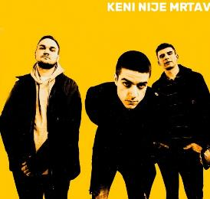
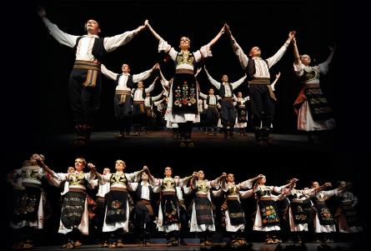
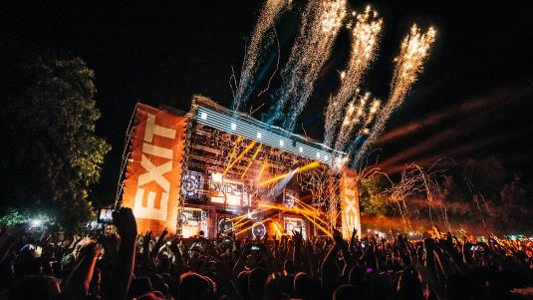
Music of Serbia represents the musical heritage of Serbia, both historical and modern. It has a variety of traditional music styles, which are part of the wider Balkan musical tradition, with its own distinctive sound and characteristics.
Serbia hosts some of the best, award-winning festivals that attract young people from all over the world.

Slide 25
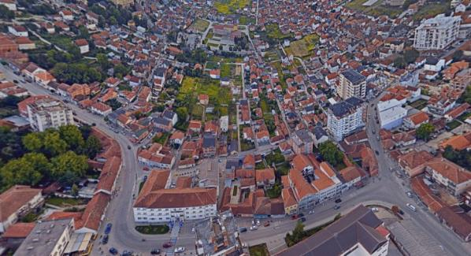
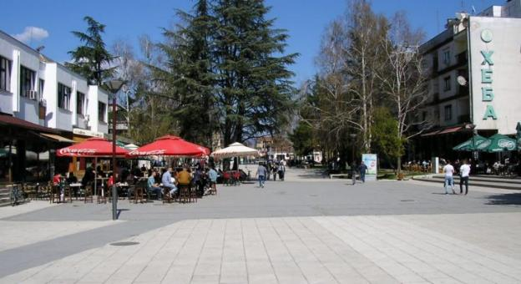
This is my town - Bujanovac
It’s multinational (Serbian, Roma and Albanian people live in it).

Slide 26
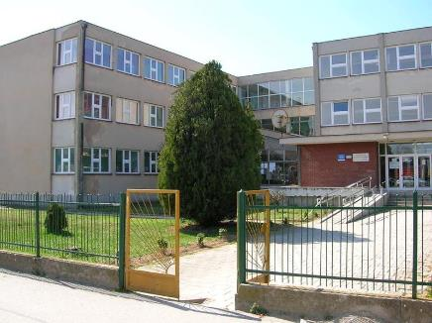
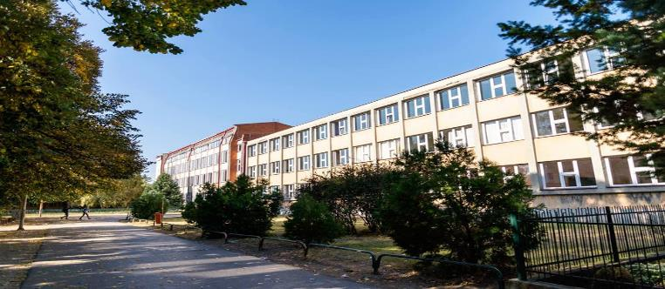
…and this is my school

Slide 27
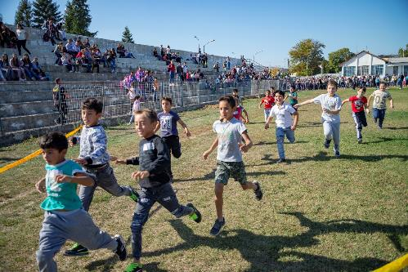
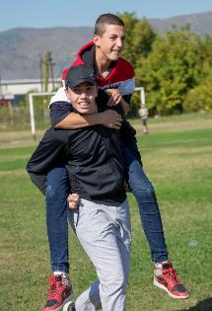
It is multinational, with many Roma and Serbian pupils.
There are many workshops in drama, ecology, human rights and music.

Slide 28
Our photography club

Slide 30
https://www.youtube.com/watch?v=8IwVG2RJv8Y

