Slide 1
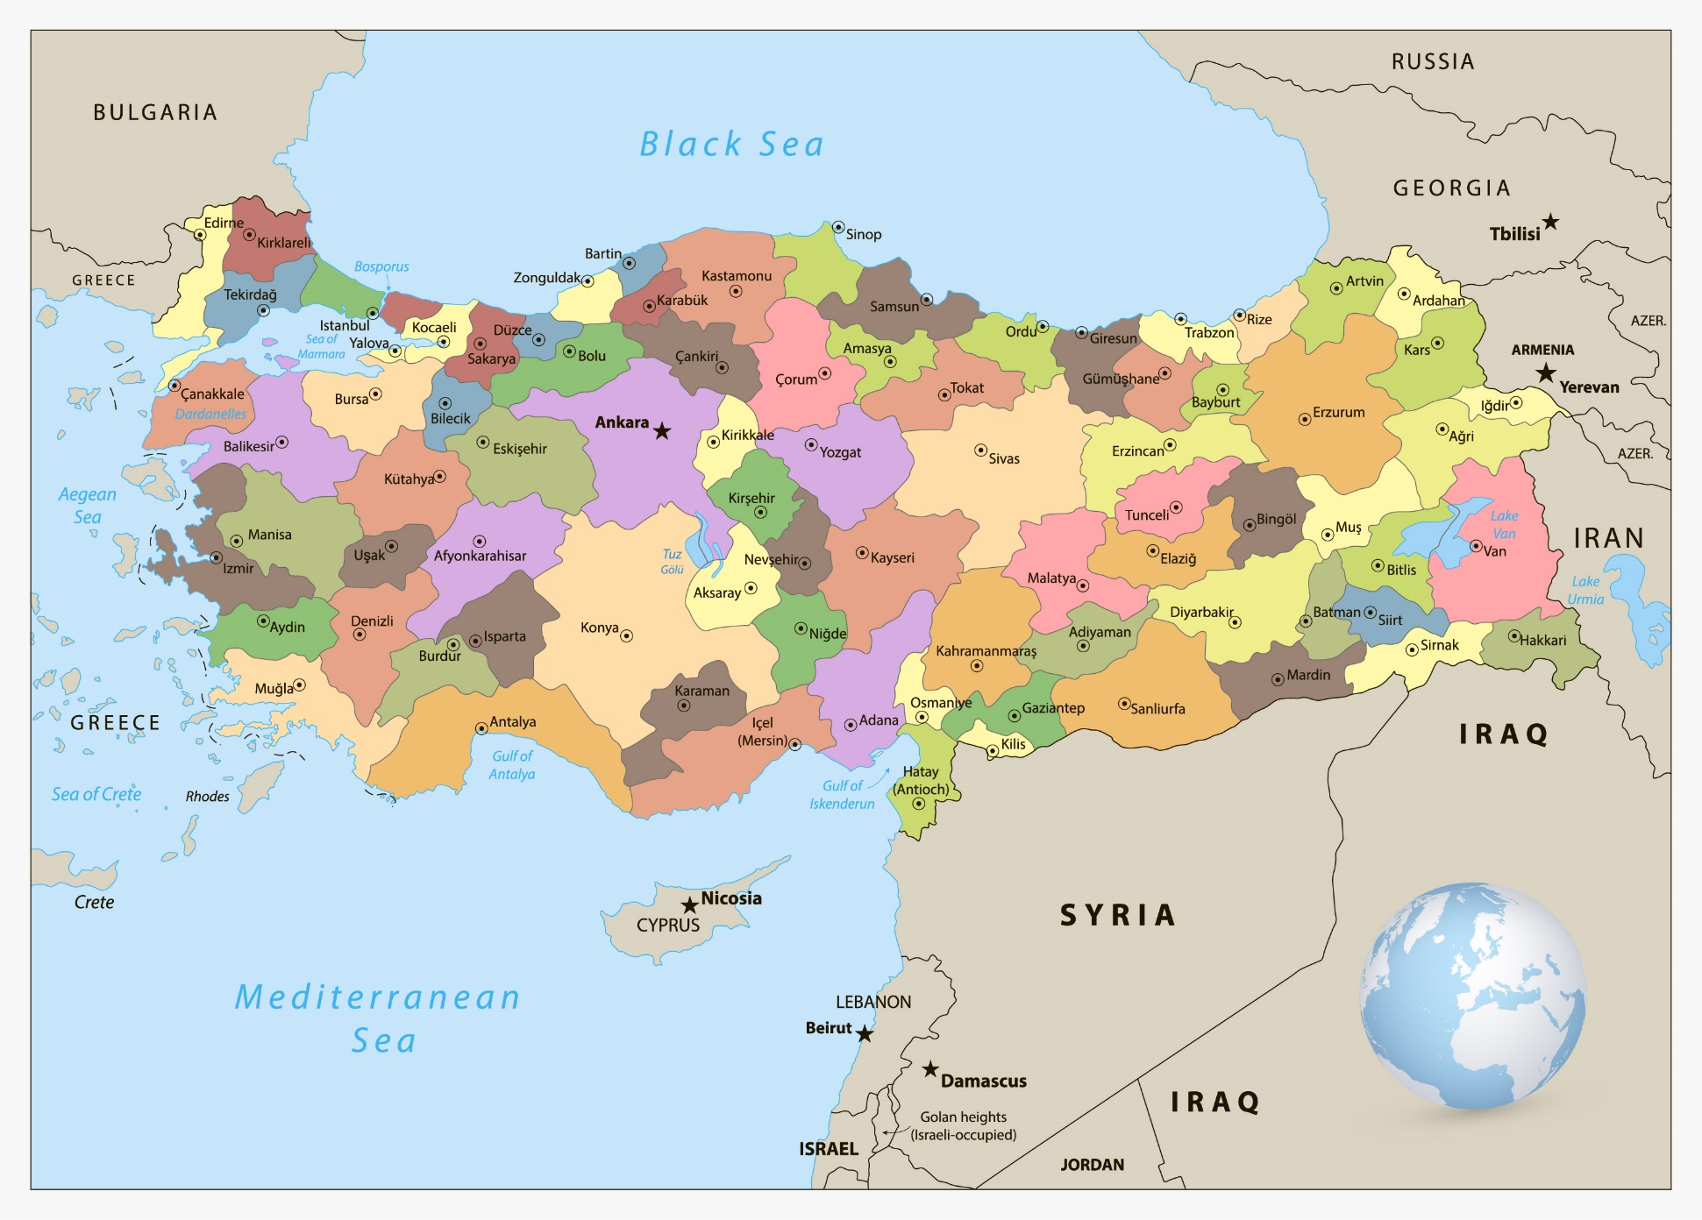
Turkey
Turkey is the only country in the world that is on two continents. Turkey is on both Asia and Europe.
Turkey is a bridge between Asia and Europe, not only in terms of geographical location but also in cultural, social and political aspects.

Slide 2
• Population: The population of Turkey is 84.34 million inhabitants.
• Official Language : Turkish
• Administrative Type: Democratic Republic
• Capital City: Ankara, but most populated city is Istanbul.
• Currency: Turkish Lira
• Official Holidays
Religious
• Feast of Ramadan. ( 3 days )
• Feast of the Sacrifice.( 4 days )
Other holidays
• New Year's Day (1st January)
• National Sovereignty & Children's Day (23rd April)
• Ataturk's Commemoration & Youth and Sports Day
(19th May)
• Victory Day (30th August)
• Republic Day (29th October 1923)

Slide 3
The border:
Turkey is bordered by three seas, the Black Sea, the Mediterranean Sea, and the Aegean Sea
Turkey is bordered by eight countries – Greece, Bulgaria, Iraq, Syria, Azerbaijan, Georgia, Armenia and Iran.
The most important cities:
Of the most important cities in Turkey, the most in terms of population:
Ankara is the capital of Turkey, with a population of about 5 million people
Istanbul: Turkey’s largest city, inhabited by about 12 million people, also contains many tourist and historic sites.
Izmir, with a population of about 3 million people

Slide 4
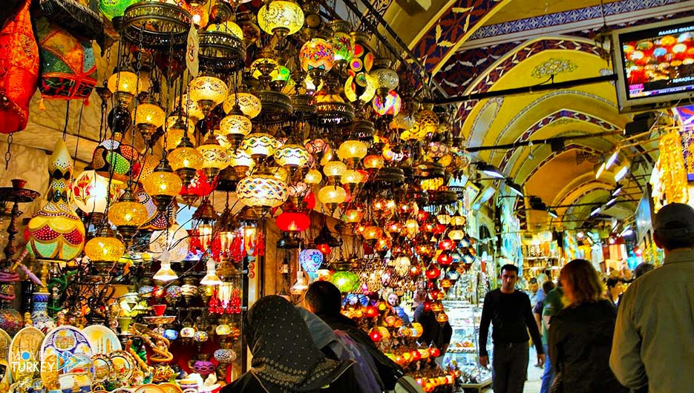
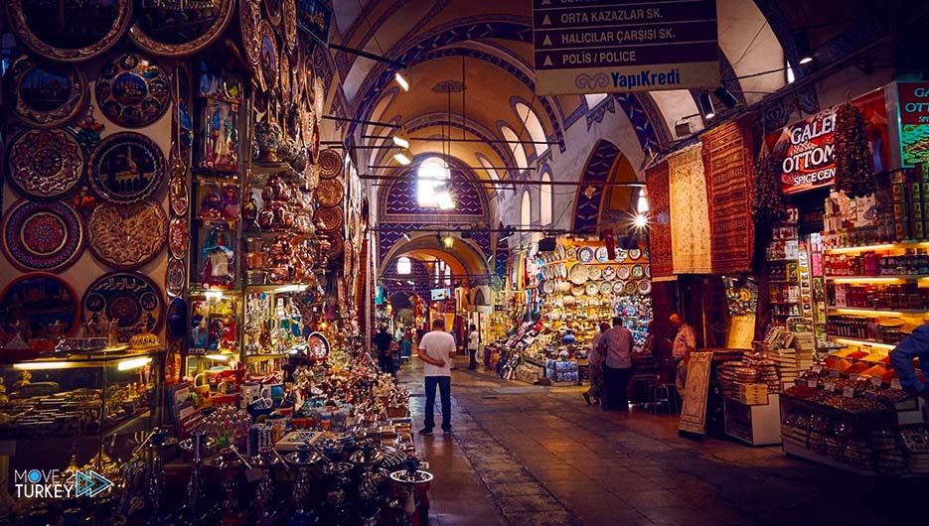
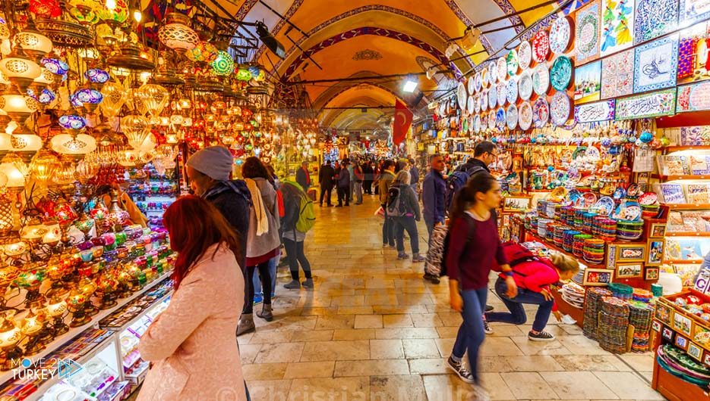
Turkey Has One Of The World’s Biggest And Oldest Malls

Slide 5
Fascinating Facts about Incredible Turkey
1. Istanbul is on two continents
Let's start with a classic: Istanbul lives on two continents. The city is separated by the Bosporus, a strait, and thus consists of a European and an Asian part. Overall, 95% of Turkey is in Asia, and 5% is in Europe.
2. Ankara, not Istanbul, is the capital of Turkey
Many people assume that it is Istanbul that is the capital of Turkey, but actually, it is the city of Ankara that is the capital. Istanbul just happens to be Turkey’s largest city. Ankara has been an important trade centre throughout Turkey’s history and has grown to become a significant trading, art and cultural hub.
3. The original name of Istanbul is "Byzantium"
The name "Byzantium" has Greek origins and refers to Byzas, the founder of the city. In 324, it was renamed to “Constantinople”, and in 1930 it was changed to Istanbul.
4. The story of Santa Claus originated in Turkey
Born to wealthy parents, Nicholas was a Christian saint and Greek bishop of Myra, who was born in Patara. Once his parents died, he received a large amount of wealth, which he would give away to the poor and needy. Legend has it that he would drop bags of gold coins down the chimneys of houses, and provide fruits to children. His good deeds spread through Europe, and locals began integrating it with their myths and legends.
5. The Turks love tea
Although you may know Turkey for their coffee, 96% of the population drinks at least one cup of tea per day. Turkish tea is robust, and they serve it in small tulip-shaped glasses. Make sure to try all their extraordinary tea flavours during your travels.

Slide 6
6. Turkey has a young demographic
Turkey has the EU’s largest young population. The average age in Turkey is around 31, and only 9% of the country’s population is over 60.
7. The national sport of Turkey is oil wrestling
Turkey’s national sport is Oil Wrestling. Oil wrestling dates back to the Ottoman Empire but today the most popular sport in Turkey is football.
8. There are 82,693 mosques in Turkey
Turkey is home to some of the most beautiful mosques in the world, as about 99% of all Turks are Muslims.
9. There are more than 30 ethnic languages in Turkey
Although Turkish is the official language of the country, more than 30 other languages are spoken regularly, including Arabic, Kurmanji and Zazaki to name a few.
10. The "Evil Eye" is the best-selling souvenir
The “Nazar boncuğu”, or “evil eye”, is a stone made from molten glass, iron and copper. A 3000-year old tradition, it is worn to protect the wearer from evil forces. The belief is that the blue colour of the stone has the power to shield from negative energy.

Slide 7
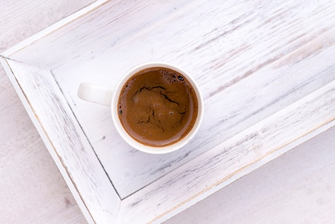
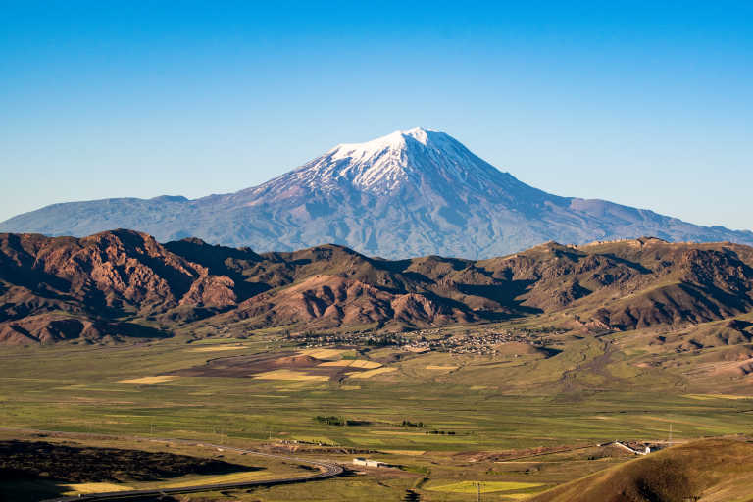
11. We owe coffee to the Turks
Although coffee doesn't come from Turkey, the Turks brought coffee to Europe in the 16th century. When in Turkey, try their classic mocha coffee, brewed in a cezve, a small copper pot.
After the Great Flood, Noah might have finally stopped at land at Mount Ararat.

Slide 8
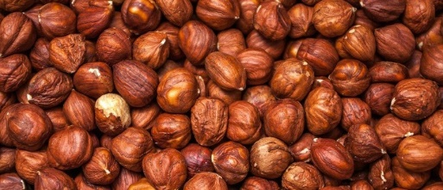
TURKEY MADE TULIPS POPULAR
TURKEY IS THE WORLD’S LARGEST PRODUCER OF HAZELNUTS
People commonly associate the flower with the Netherlands yet it is really thanks to Turkey that the tulip became popular around the world.
The Flemish Ambassador to the 16th-century court of Suleiman the Magnificent returned to Amsterdam with tulip bulbs, introducing the plant to Holland.
There are a number of products synonymous with Turkey, most famously Turkish delight and coffee. What people may not realize is that Turkey produces the largest proportion of the world’s hazelnuts.
In total, Turkey grows around 73% of all hazelnuts which are exported around the globe to make treats such as praline and chocolate and hazelnut spreads.

Slide 9
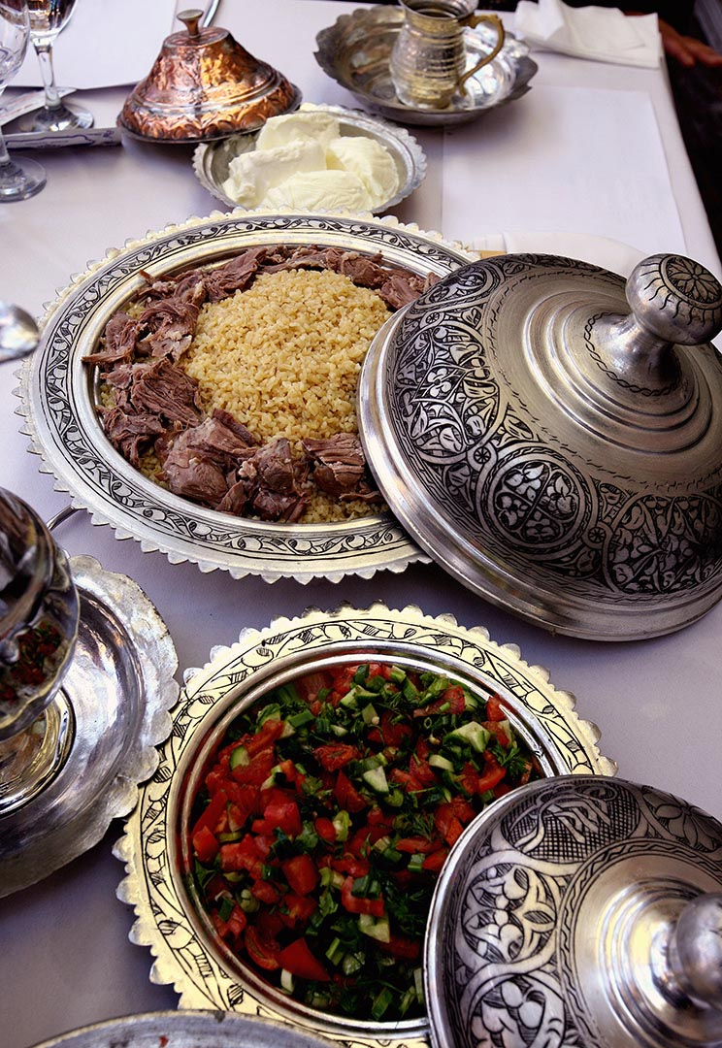
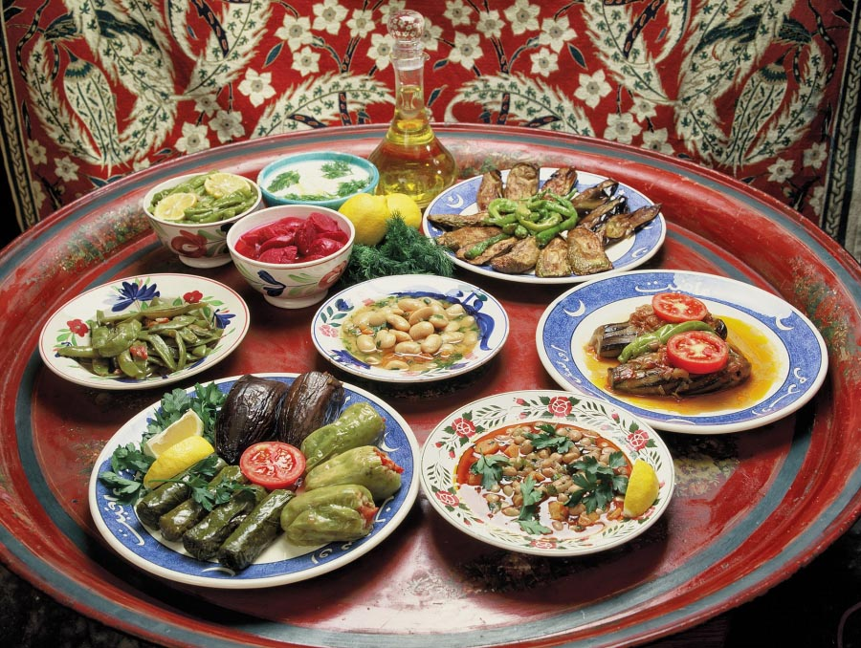
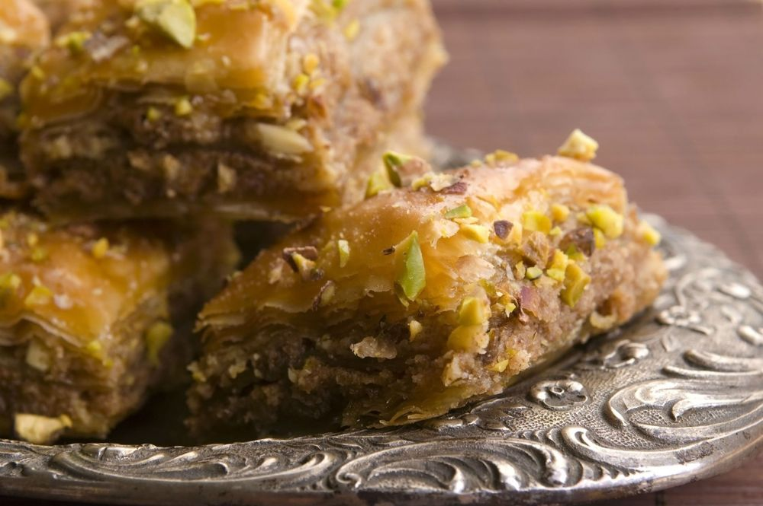
There are many similarities between Serbian and Turkish cuisine.

Slide 10
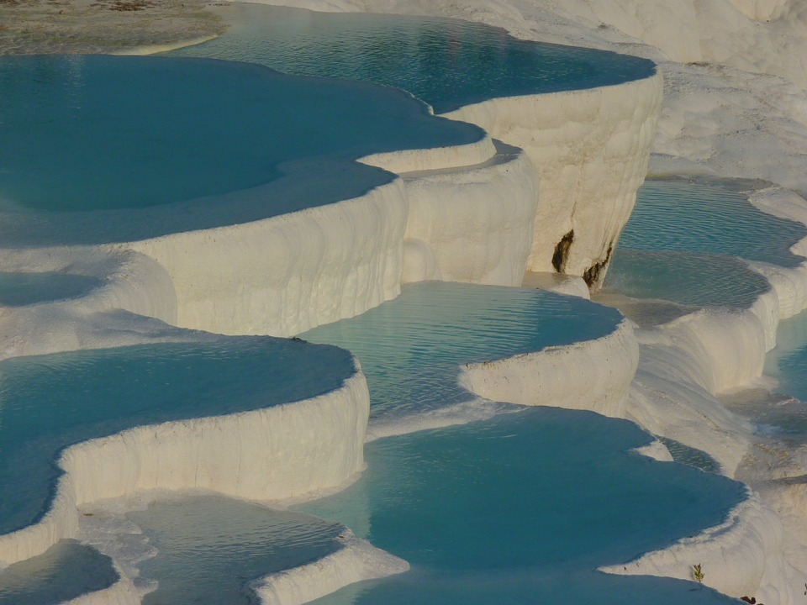
Pamukkale, the center of natural thermal spring waters, which in Turkish translates to "Cotton Castle."
Cotton castle. Velvet white rocks. White paradise. Magically healing hot water springs.
https://www.youtube.com/watch?v=VaAY9NuctMY

Slide 11
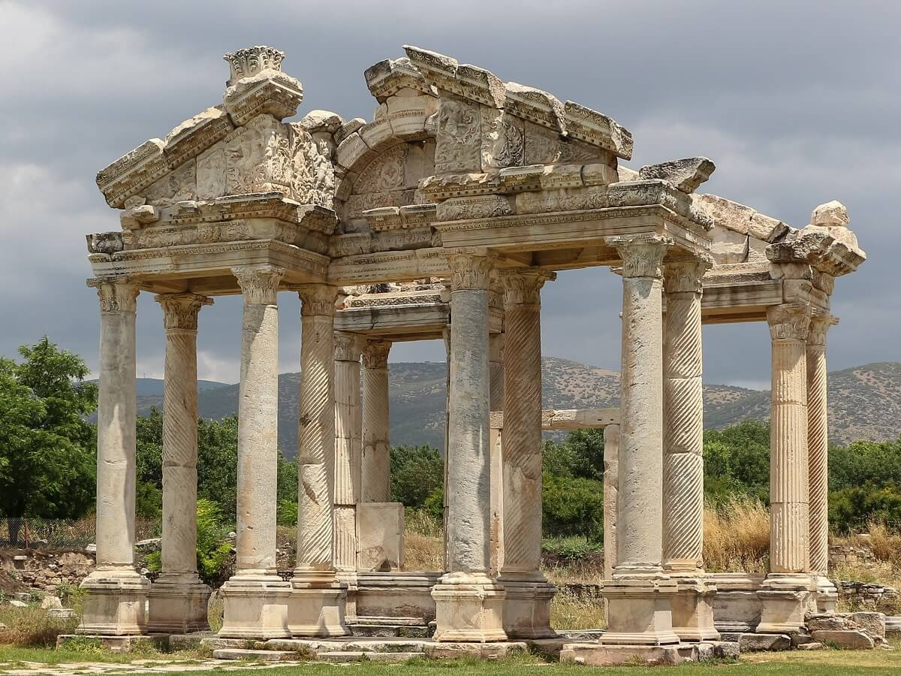
Temple of Aphrodite
Aphrodisias
Archaeological site
The ancient Greek city of Aphrodisias took a much-deserved place on the Unesco World Heritage List in 2017, but continues to remain quite unknown to travellers. Named after Aphrodite, the goddess of love, the most stunning structure is the Temple of Aphrodite.
https://en.antaliy.com/aphrodisias/

Slide 12
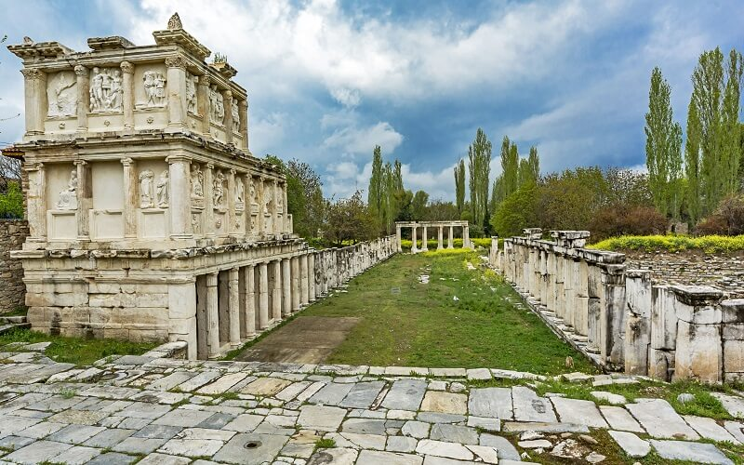
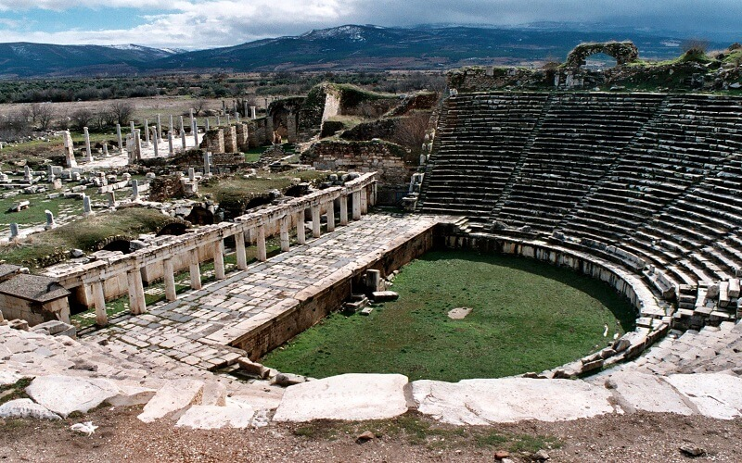
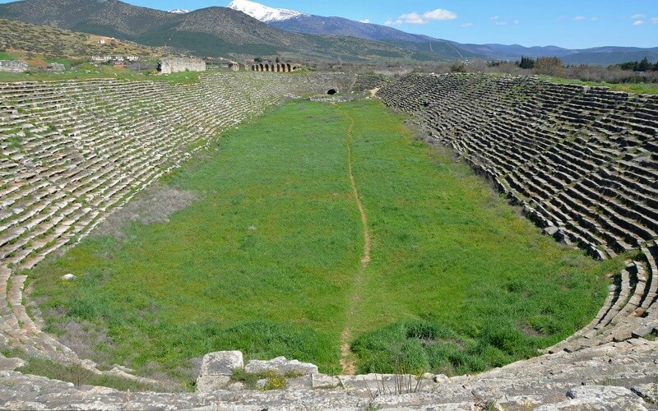
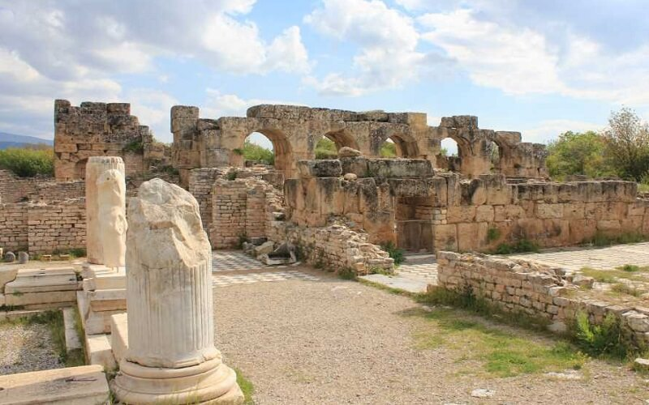
Sebasteion Temple
Aphrodisias Amphitheatre
Aphrodisias Stadium
Hadrian’s Bath

